Slide 1
A Progression Towards Genocide
How Nazi Germany Systematically Began the Holocaust

Slide 2
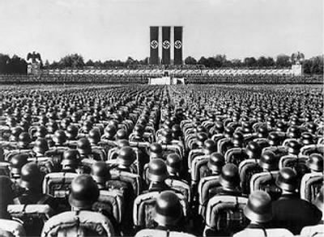
The Process of the Holocaust
The Holocaust itself was not an immediate occurrence.
It took time and persuasion to convince the German people.
It was systematic, and each new law led to Hitler’s Final Solution

Slide 3
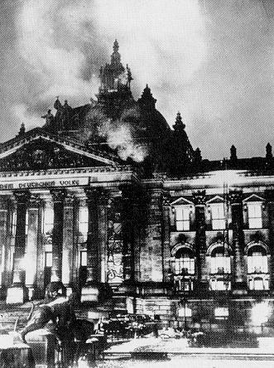
Burning of Reichstag Building
Reichstag Building: central government building for the Weimar Republic
Hitler had the Nazis secretly set the building on fire on February 27, 1933.
This enabled Hitler to request more power from the government.
German Parliament passes the Enabling Act, giving Hitler full dictatorial powers

Slide 4
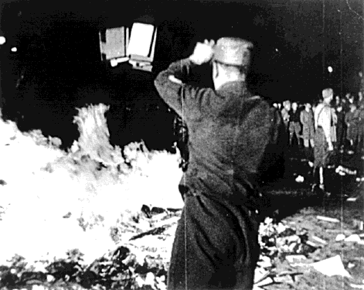
Hitler Suspends Rights
Following the Enabling Act, Hitler suspends rights to freedom of press, speech and assembly.
The media is now controlled by the Nazi government.
May, 1933, Nazi government has widespread German assemblies to burn books by Jewish authors and authors who do not agree with the Nazis.

Slide 5
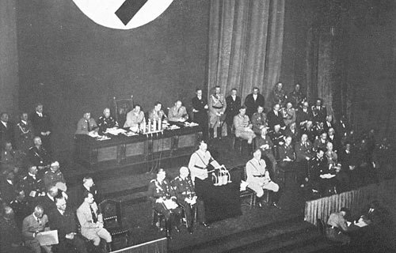
Nuremberg Laws
Nuremberg Laws
Immediately removed citizenship from Jewish people
Made marriage, sexual relationships, and employment between Aryans and Jews illegal.
Jews must also register with the government.

Slide 6
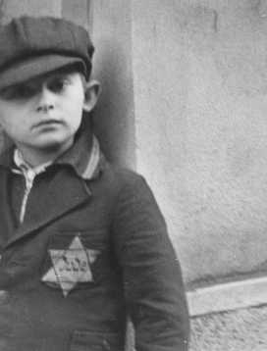
Rights Taken From Jews
Jews are banned from certain professions
Dentistry, Teaching Germans, Lawyers
Jewish Passports must be marked with a letter “J”
Jews six years of age and older must wear a yellow Star of David on their clothes.

Slide 7
Assignment
Using your copy of the translated Nuremberg laws, describe why you think the Nazis took these steps first instead of immediately beginning the Holocaust.

