Slide 1
Accelerating Change in the West
Western Europe in the High Middle Ages

Slide 2
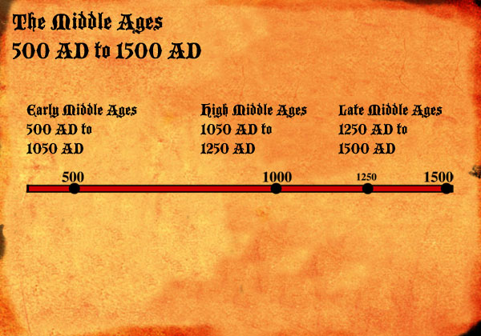
Early to High Middle Ages
European development hindered from about 700-1000
Largely due to invasions from Muslims, Magyars, and Vikings
Had mostly ended by 1000.
Climate begins to improve with a warming trend that began in 750
High Middle Ages: time of growth and expansion
European population goes from 35 million in 1000 to 80 million in 1340
More land used for cultivaiton

Slide 3
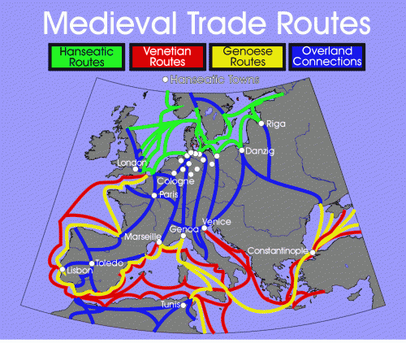
Growth of Trade
2 major areas begin to conduct long distance trade; Northern Europe and Northern Italian cities
Aided through the development of large trading fairs (especially in Champagne area of France) which allowed northern and southern merchants to trade

Slide 4
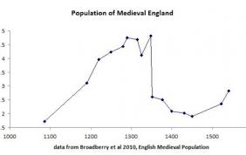
Growing Population and Economics
Town and city populations rise
Venice had around 150,000 by 1400
Still smaller than great cities elsewhere in the world
New specializations, organized into guilds

Slide 5
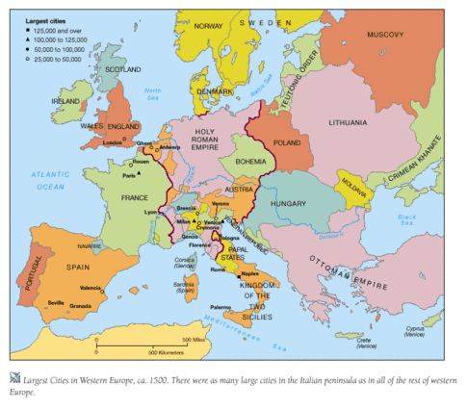
Growth of Territorial States
Growing population leads
Kings begin to consolidate their authority during the 11th-13th centuries
Some areas did not develop territorial kingdoms (Italian city-states or Germanic principalities)

Slide 6
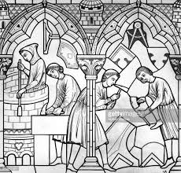
New Opportunities for Women
Number of urban professions open to women
With increased trade, there is a shift from agriculture to manufacturing
Widows of great merchants could continue husband’s business
Opportunities declined by 15th centuries

