Slide 1
Alexander the Great and the Hellenistic Era
The dissemination of Greek/Western culture in the East

Slide 2
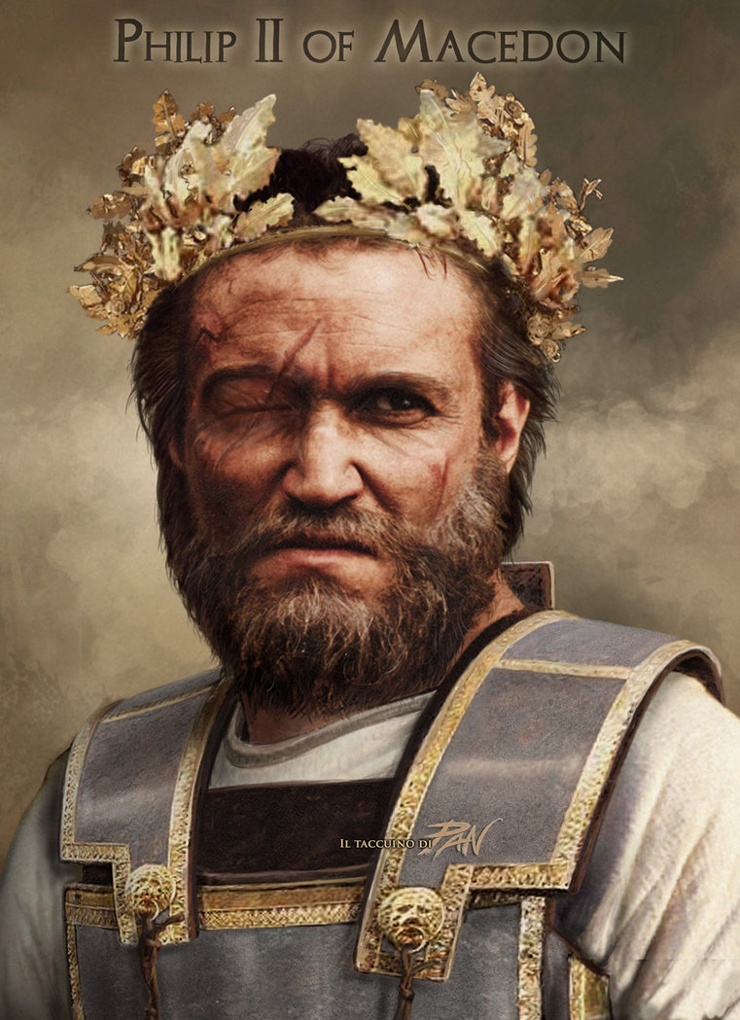
Philip II of Macedon
Alexander’s Father
Conquered and unified Greek city-states under his own government by 338 B.C.E.
Had his son tutored by Aristotle
Had planned on an expansive campaign to conquer Persia but was poisoned before he could execute it.

Slide 3
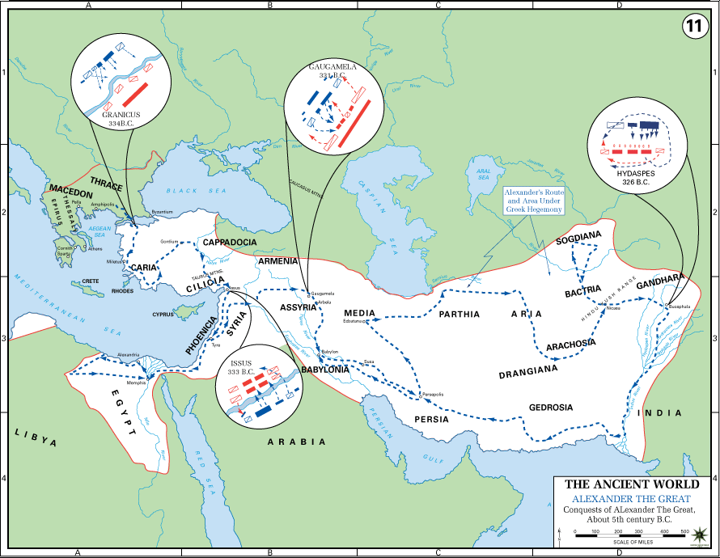
Alexander the Great
Alexander will create a massive Greek empire that will run from Greece to as far east as Afghanistan and India and south to Egypt and India.
  Alexander takes control of Macedonia at age 22 (333 BCE)
  Begins by uniting what remained of independent Greek city states
  Pushes his army east, than south into Africa, then returning to push into Asia

Slide 4
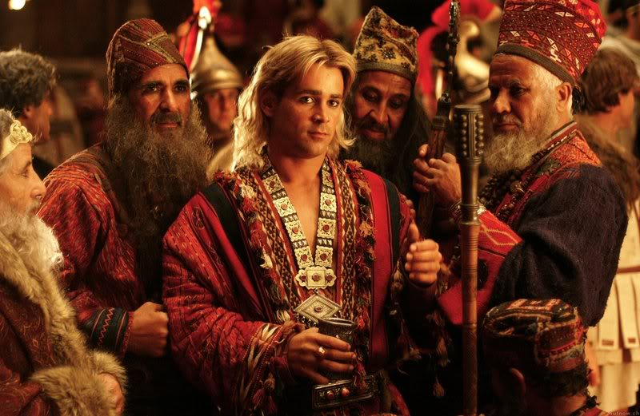
Alexander and Diverse Cultures
Alexander would often adopt and take on certain aspects of the cultures of the people he conquered.
  Had himself anointed as a pharaoh in Egypt and declared himself “son of the gods”
  Also declared himself “Shahanshah,” Persian for great king, or king of kings
  Would often dress in Persian attire and participate in Persian style feasts, holidays

Slide 5
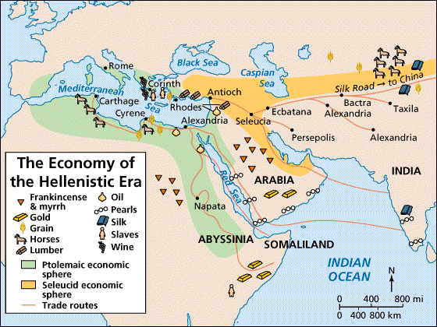
Hellenistic Era
Alexander’s greatest, longest lasting accomplishment is the spreading of Greek culture through Asia and Egypt.
  His conquests mark the beginning of the Hellenistic Era (323-30 BCE)
  Spreads Greek culture throughout the lands he conquers
  Ptolemy I Soter establishes the library of Alexandria which contained over 700,000 volumes of books and scrolls

Slide 6
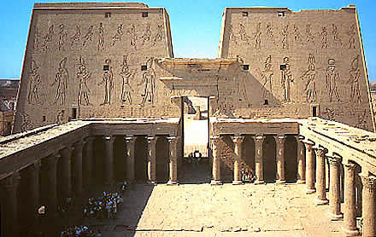
Greek Culture and Power
Greek becomes the official language of the powerful and rich from the Mediterranean to India
  Indian monarch Ashoka published his decrees in both Greek and Hindi
  Many Jews are attracted to Greek culture as Alexander takes land conquered by the Persians
  Egyptian texts began to be written in Greek and examples of Greek architecture begin to appear

Slide 7
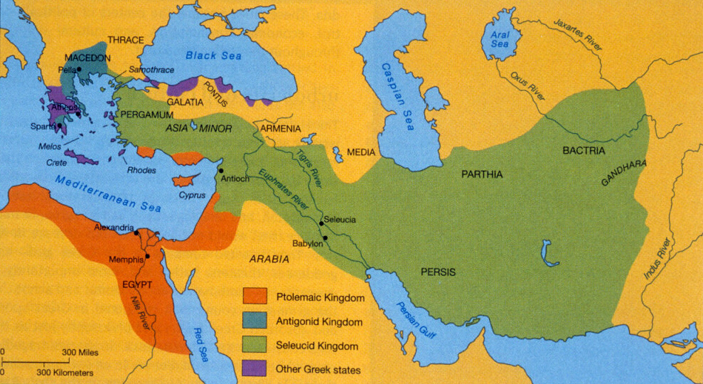
Diversity and Hellenistic cities
Diversity becomes a key aspect of Hellenistic cities
  No longer are they independent, separate city-states, but rather conquest states.
  People were free to move about cities of the empire, and this encourages trade and tolerance
  Macedonians/Greeks do still have a higher spot on the societal structure.

