Slide 1
Alternatives to Civilization: Bantu Africa

Slide 2
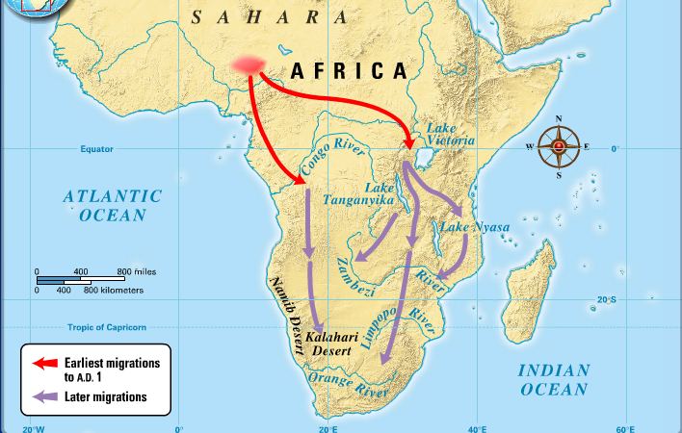
Movement of Bantu Speaking People into Africa south of equator
Began around 3000 B.C.E. from southeastern Nigeria and the Cameroons
Over time, 400 distinct Bantu languages developed
By 1st century C.E., Bantu agriculturalists occupied forest regions of equatorial Africa; some had probably reached East African coast
Spread to most of eastern and southern Africa
Movement was not conquest or self-conscious migration

Slide 3
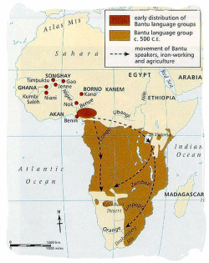
Advantages of Bantu Speaking Peoples
Interacted with established societies
Numbers: agriculture supports population increases
Disease: Bantu brought new diseases to people with little immunity
Iron
Gathering and hunting peoples were either displaced, absorbed, eliminated

Slide 4
Bantu Societies
Bantu societies will develop into many distinct societies:
  Kenya: decision making by kinship and age structures
  Zimbabwe and Lake Victoria region: larger kingdoms
  East African Coast after 1000 C.E.: rival city states

Slide 5
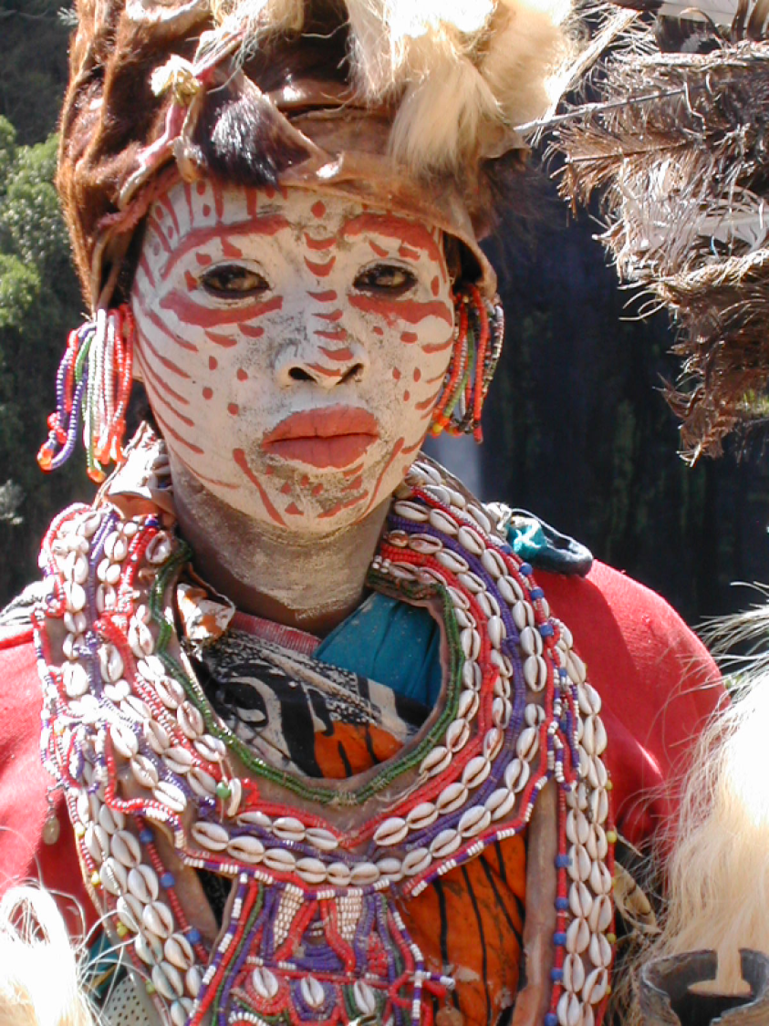
Bantu Religion
Religion placed less emphasis on a remote high god and more on ancestral or nature spirits
  Sacrifices (especially cattle) to access power of dead ancestors
  Power of charms was activated by proper rituals
  Widespread belief in witches
  Diviners could access world of supernatural
  Based on the notion of “continuous revelation”: new messages will come from the world beyond
  No missionary impulse

