Slide 1
An American Network
Commerce and Connection in the Western Hemisphere

Slide 2
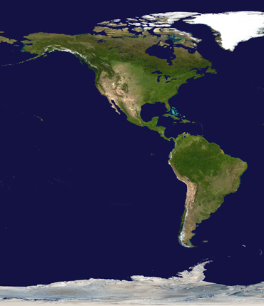
American Trade Networks
No sustained interaction occurred between Western an Eastern hemispheres before the voyages of Columbus
American trade networks were not as dense as Afro-Eurasian ones
  Had several limitations:
    Lack of domesticated large mammals
    Lack of wheeled vehicles
    Lack of large oceangoing ships
    North/South Orientation
Local/Regional commerce flourished but not long distance trade
Cultural traditions did not spread as widely as in Eastern Hemisphere

Slide 3
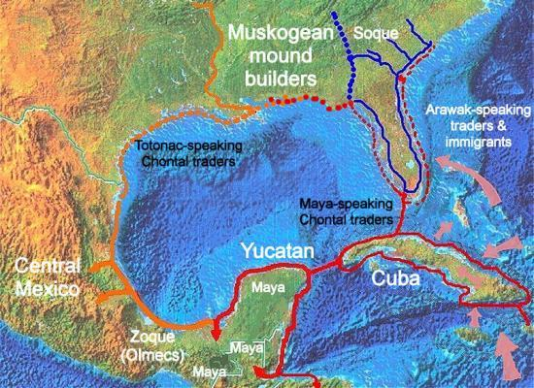
Several Small Trade Networks
A “loosely interactive web” existed from the Great Lakes to the Andes
  Cultural elements spread gradually
  Evidence of at least indirect contact with each other
  Amazon and Orinoco river had exchange networks
  Caribbean peoples conducted interisland trade Chincha people traded along Pacific coast of South America

Slide 4
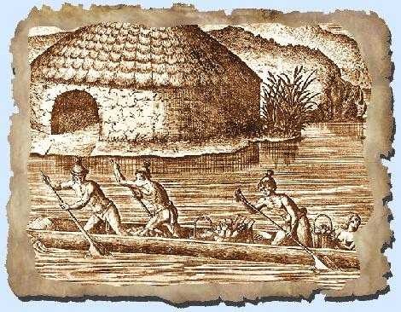
Major Trade in Mesoamerica
Maya and Teotihuacan traded by land
Chaco canyon culture also interacted with Mesoamerican societies
Maya traded by sea on both coasts
  Dugout canoes
Aztecs of the 5th century had professional merchants called pochteca.

Slide 5
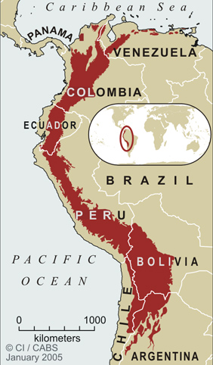
Trade in the Andes
Major trade network in the Andes was largely state run
  Inca distributed supplies from great state storehouses
  20,000 miles of road
  Some local exchange at fairs and along borders of the empire

