Slide 1
China’s trade and religion
The Spread of Innovations and Buddhism

Slide 2
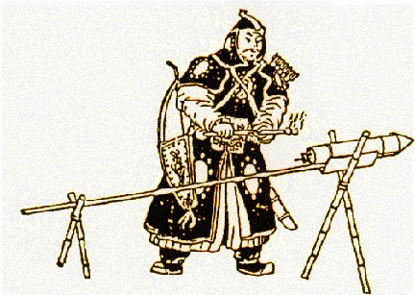
China’s Impact on Eurasia
Many of China’s technological innovations spread beyond its borders
  Salt production used through evaporation
  Papermaking
  Printing (though resisted by Islamic world)
  Gunpowder: invented around 1000 C.E.
  Chinese textile, metallurgical, magnetic compass and other naval innovations
  These inspire imitation and innovation in Eurasia

Slide 3
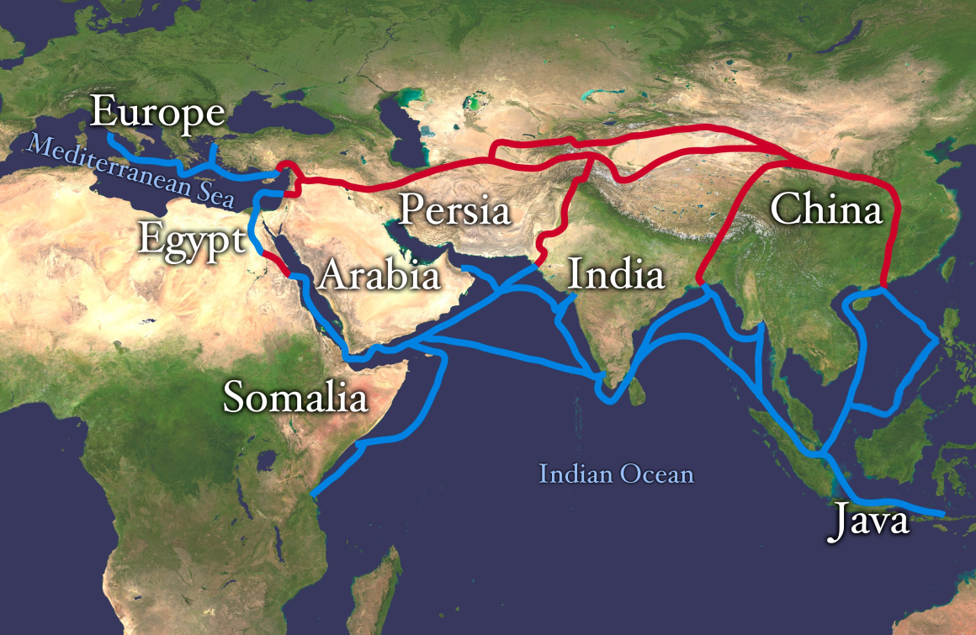
On the Receiving End: China as an Economic Beneficiary
China learned sugar and cotton cultivation and processing from India
China was transformed around 1000 C.E. by introduction of new rice strains from Vietnam

Slide 4
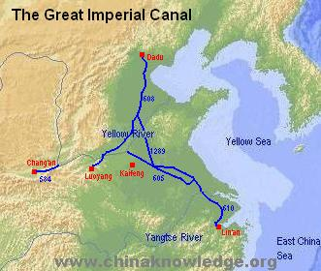
Growing Participation in Indian Ocean trade
Foreign merchant settlements in southern Chinese ports by Tang era
Sometimes bought violence; massive massacre of foreigners in Canton in the 870s.
Transformation of southern
China to production for export instead of subsistence farmers

Slide 5
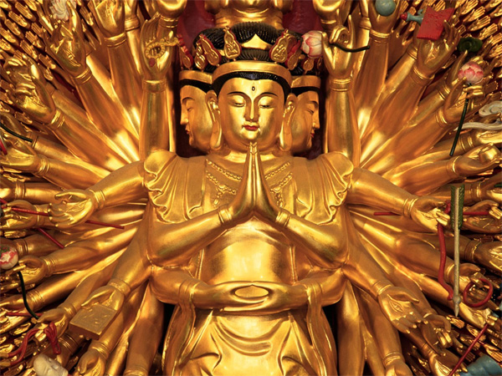
Buddhism and China
Buddhism was perhaps India’s most important gift to China
  Only large-scale cultural borrowing until Marxism/Communism
  China was the base for Buddhism’s spread to Korea and Japan
  Buddhism entered China via Silk Roads in 1st and 2nd centuries C.E.
  Had little appeal at first
  Indian culture was too different from Chinese

Slide 6
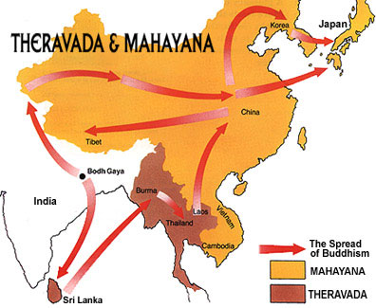
Buddhism Takes Hold in China
Becomes popular between 300-800 C.E.
Collapse of Han dynasty brought chaos and discredited Confucianism
Buddhism was comforting; provided lots of social services through monasteries
Mystical aspect to Buddhism
Buddhists made serious efforts to present their ideas in a way that was accessible to Chinese
Mahayana form of Buddhism became popular

Slide 7

Resistance
Growth of Chinese Buddhism provoked resistance and criticism
Deepening resentment of the Buddhist establishment’s wealth
Foreign, so many considered it offensive
Monastic celibacy and withdrawal didn’t exactly matchup with Confucian-based family system

Slide 8
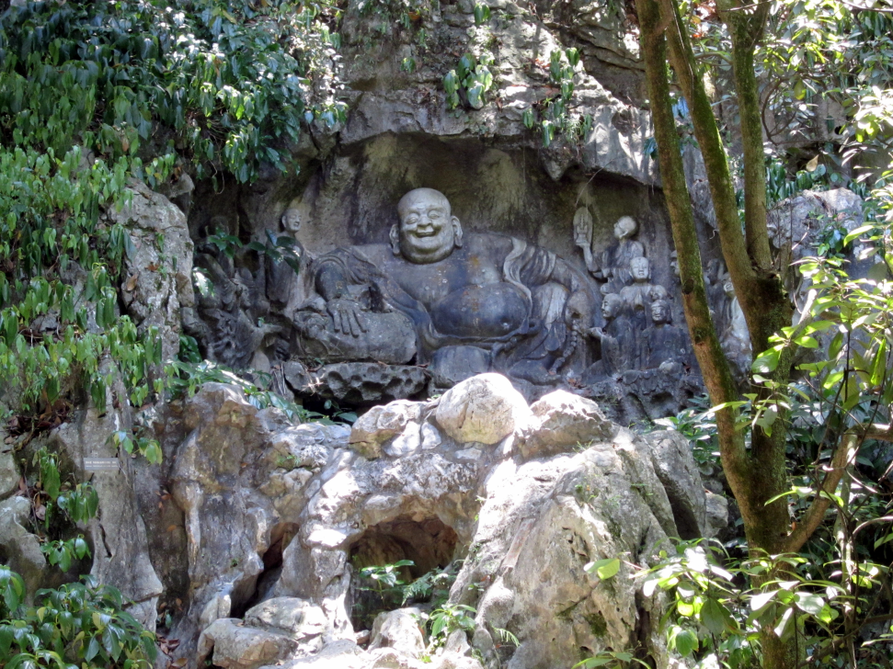
Government Action Against Foreign Religions
Began between 841-845
260,000 nuns and monks forced into a secular life
Thousands of temples, shrines destroyed.
Buddhists forbidden to use precious metals or gems for their images.
Buddhists did not vanish from China, however, it remained an important element of popular religion

