Slide 1
Civilizations of Mesoamerica
Maya and Teotihuacán

Slide 2
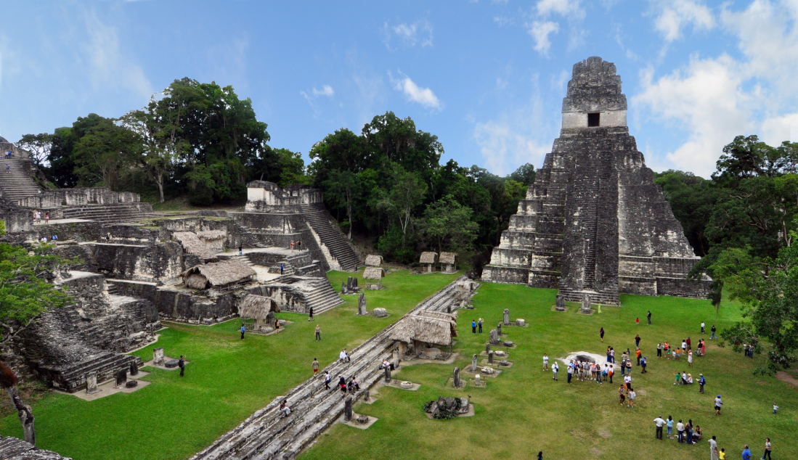
Commonalities between Maya and Teotihuacán
Both civilizations lacked interaction with other cultures, including within the Americas.
  Developed without large domesticated animals or ironworking
Both would develop intensive agricultural techniques
Shared economies based on market exchange
Frequent interaction between them

Slide 3
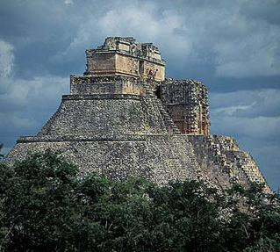
Culture of the Maya
Maya ceremonial centers developed as early as 2000 B.C.E. in Guatemala and Yucatan
Cultural achievements:
  Advanced mathematical system
  Elaborate calendars
  Creation of most elaborate writing system in the Americas
  Large amount of monumental architecture (temples, pyramids, palaces, plazas)

Slide 4
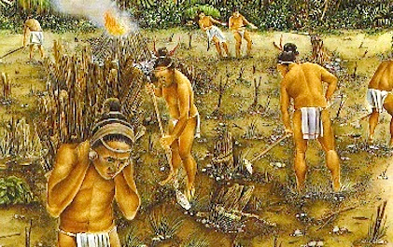
Mayan Economy
Agriculture had large scale human engineering (swamp drainage, water management and irrigation)
Supported a substantial elite and artisan class

Slide 5
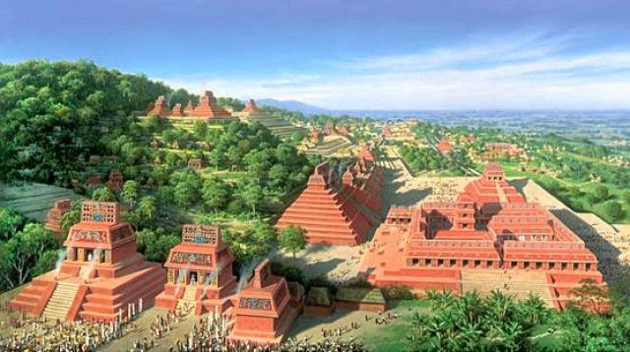
Mayan Government
Political system of city-states and regional kingdoms was highly fragmented
  Frequent warfare; capture and sacrifice of prisoners
  Densely populated urban ceremonial centers
  No city-state ever succeeded in creating a unified empire

Slide 6
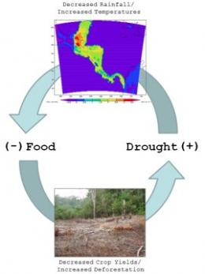
Fall of the Maya
Rapid collapse experienced in the century after a long term drought began in 840 C.E.
  Population dropped by at least 85%
  Elements of Maya culture survived, but not the great cities
Reasons for collapse:
  Rapid population growth after 600 C.E. outstripped resources
  Political disunity and rivalry prevented a coordinated response to drought
  Frequent warfare

Slide 7
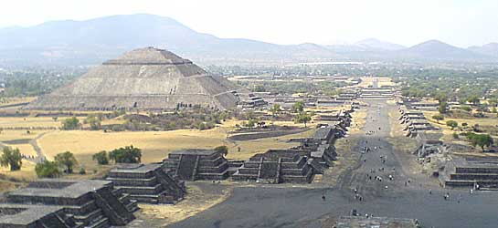
Teotihuacán
City began around 150 B.C.E.
By 550 B.C.E. the population was between 100,000-200,000
Much about the original city is unknown
Grid pattern in planning of the city
Specialized Artisans
Little evidence of rulers or of tradition of public inscriptions

Slide 8
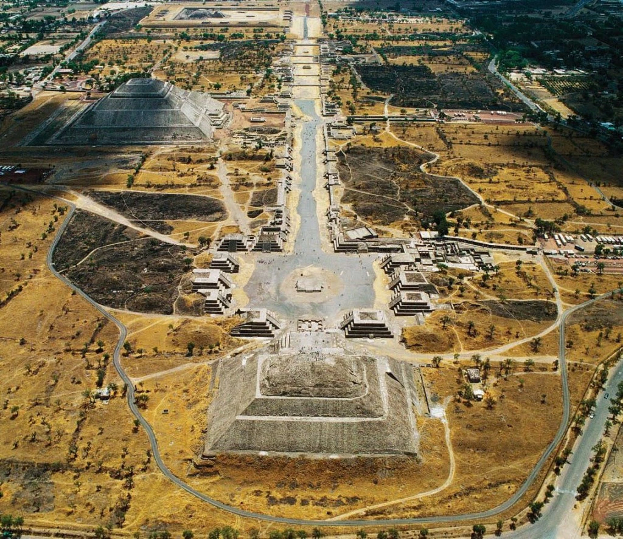
Teotihuacán’s influence on Mesoamerica
Directly administered perhaps 10,000 square miles
Armies spread as far as Mayan lands
Had diplomatic connections with other areas
Vast trade
Spread art and architecture styles
Mysterious collapse around 650 C.E.

