Slide 1
Cultural Tradition of Classical Greece
Search for a Rational Order

Slide 2
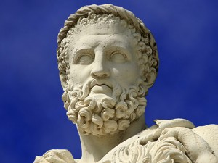
Greek Religious Tradition
Throughout the existence of a Greek empire, Greece maintained a tradition of polytheism, but this did not endure.
The Greek tradition that did last was a search for rational order

Slide 3
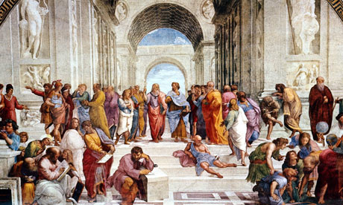
Greek Rational Order
Greek intellectuals began to abandon the old, mythological framework of world understanding. Instead they believed:
  The world is a physical reality governed by natural laws
  Humans can understand those laws
  Human reason can work out a system for ethical life

Slide 4
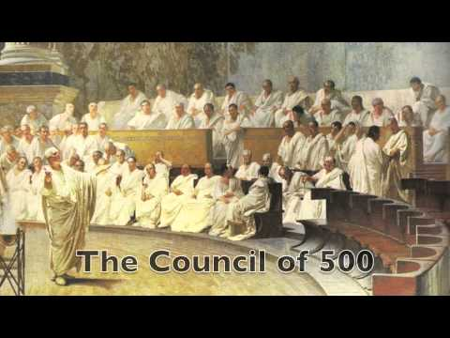
Possible Causes for this Shift
Diversity among Greek city-states
Incoherence of mythology
Intellectual stimulation of great civilizations
Growing role of law in Athenian political life

Slide 5
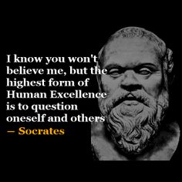
The Greek Way of Knowing
Flourished between 600-300 B.C.E.; same time as Greek city-states
Key element: Constant questioning of received wisdom and arguments using logic
Socrates 469-399 B.C.E.
  Constant questioning of assumptions
  Conflict with govt. over Athenian democracy
  Accused of corrupting the youth and sentenced to death

Slide 6
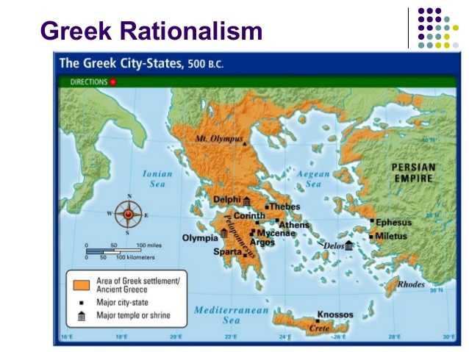
Greek Legacy
Many people continued religious beliefs and practices, but Greek rationalism spread widely
  Helped by Alexander's Empire and then the Romans
  Christian theology expressed in Greek philosophical terms
  Classical Greek texts preserved by Byzantine Empires
  Part of Jewish and Islamic cultures

