Slide 1
Darwin and Social Darwinism

Slide 2
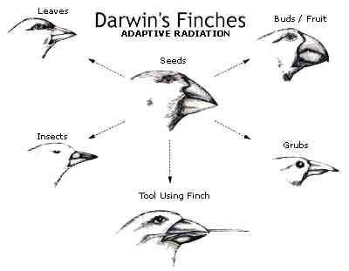
Charles Darwin
One of the most controversial ideas from this era came from Charles Darwin
After studying animals across the globe, in particular in the Galapagos, Darwin developed his theories on natural selection and published them in his book On The Origin of Species
Stated that animals produced more offspring than the food supply could support, as a result nature “selects” the animals with the best traits to survive and pass those traits on.
Every animal, including man, evolved in this manner.

Slide 3
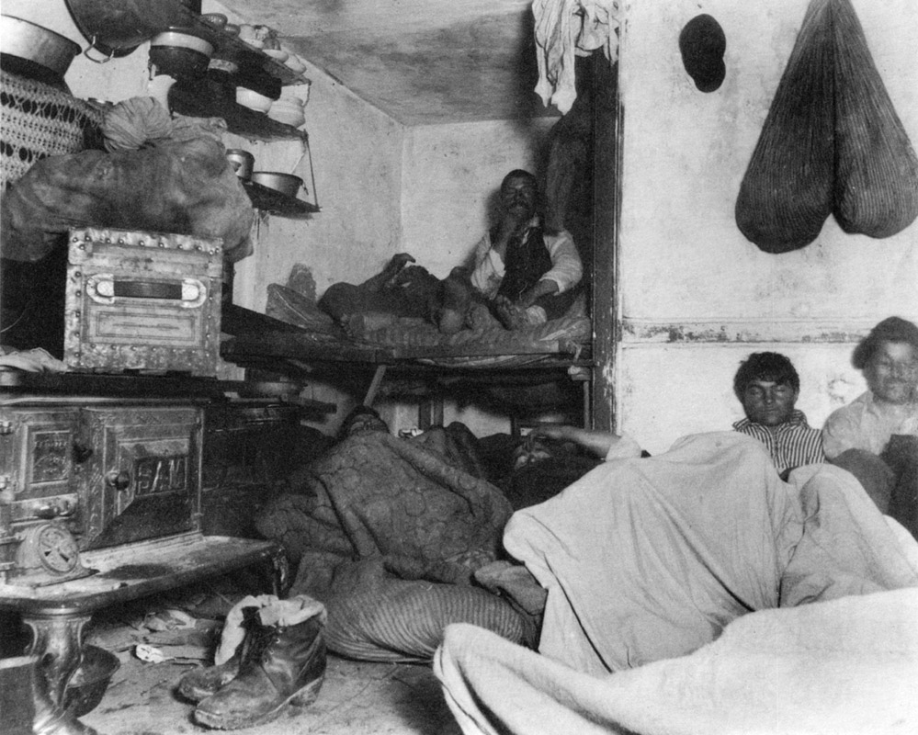
Social Darwinism
Taking the theories of Darwin, Herbert Spencer developed a new concept by applying Darwin’s theories to society.
One industry that put another out of business was obviously more “fit” for the business world
Sold a better/cheaper product, worked more efficiently, etc.
Also was applied to individuals
Unfortunately, this theory became the backbone for several racist movements throughout the following generations.

Slide 4
Assignment
In your opinion, does Social Darwinism apply to industries? Society? People?
Write on a separate sheet in at least 1 paragraph (6 sentences).

