Slide 1
Elizabethan England

Slide 2
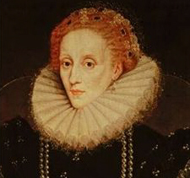
Elizabeth I
Daughter of Henry VIII and Ann Boleyn, Elizabeth Tudor became Queen Elizabeth I, November 17, 1554
During the reign of Mary Tudor, or Bloody Mary, Elizabeth was imprisoned due to the belief that she was plotting to steal the throne.
With Queen Mary’s failing health, however, she finally became Queen.

Slide 3
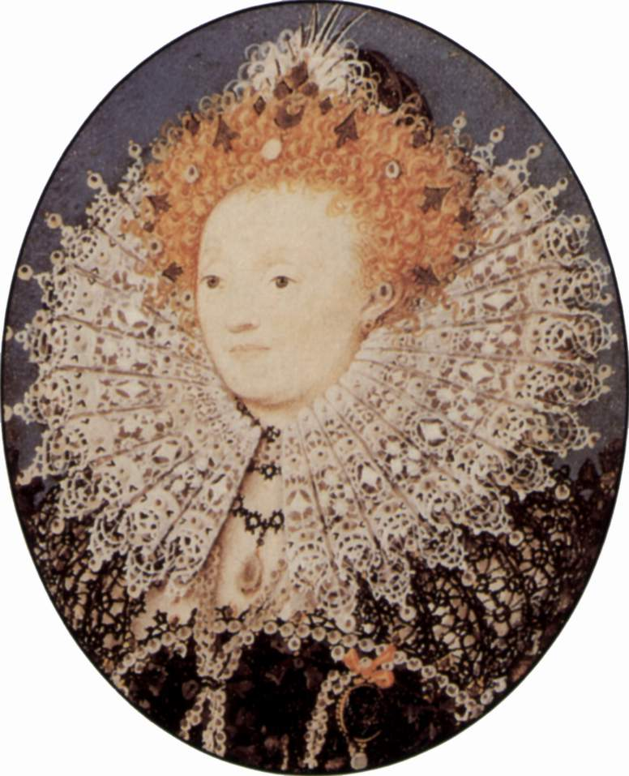
The Reign of Elizabeth I: The Virgin Queen
Throughout the early part of her reign, rumors began to abound about who the Queen would marry.
The earliest and most likely contender was Robert Dudley, a close friend and Earl of Leicester.
However, this politically would have been a nightmare
His father was dubbed a traitor and the mysterious death of his wife led some to believe that he murdered her so that he could marry the queen
As a result, Elizabeth would never marry for several reasons
Did not want to lose her authority
Feared someone using her to spread Catholicism back through England.

Slide 4
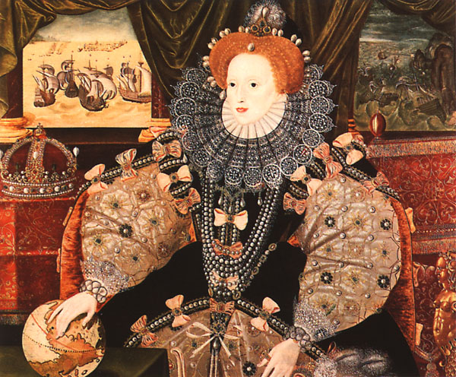
Spanish Armada
King Phillip of Spain had originally been married to Mary Tudor.
Early in Elizabeth’s reign, their relationship had been one of acceptance at best.
However, as trade and imperialism begin to grow, a rivalry builds between the Spanish and the English
Spain had controlled the Atlantic for most of Elizabeth’s reign, however, the queen constructed a larger, more improved navy and defeated the Spanish Armada

Slide 5
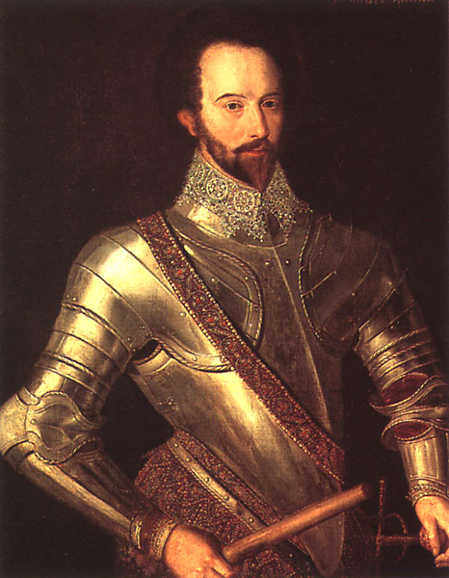
Colonization
With the defeat of the Spanish, the English were no longer resistant to explore, colonize and spread their empire.
Sir Francis Bacon and Sir Walter Raleigh found some of the first English colonies in the Americas

Slide 6
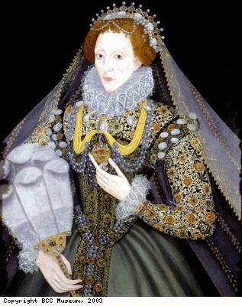
Elizabeth and Religion
Elizabeth wanted to make a more moderate approach to religion than her late brother and sister.
Kept Book of Common Prayer
People were to receive communion kneeling, as was Catholic tradition.
Did not require the people to take an “Oath of Supremacy” stating that she was now the head of the Church

Slide 7
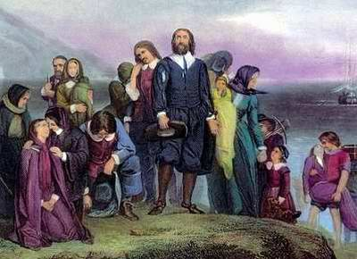
Elizabeth, Queen for the People
Her primary goal as queen was to serve England as well as keep the peace.
Religious conflict continued, especially as a group of Puritans emerged, wanting to further distance themselves from the Catholic Church.
Parliament passed many laws in order to eliminate the threat, but Elizabeth made sure they were rarely enforced.

