Slide 1
English Reformation
Religious Turmoil and Sibling Rivalry

Slide 2
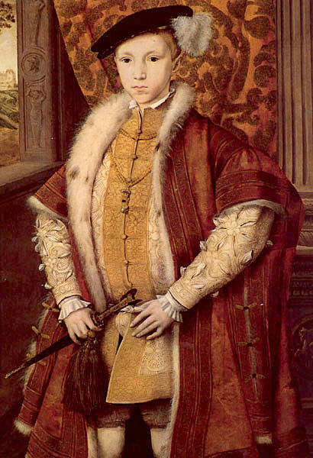
Edward VI: Protestantism takes hold in England
After Henry’s death in 1547, his sole surviving son, Edward, took the throne at the age of 9.
Edward, and more so his advisors, were devout Protestants and began to move the Anglican Church farther from Catholicism.
Eliminated clerical celibacy, allowed priests to marry.
Had services conducted in English, not Latin as the Roman Catholics did.
Had Archbishop Thomas Cramner create the Book of Common Prayer which created new, Protestant practices and rituals.

Slide 3
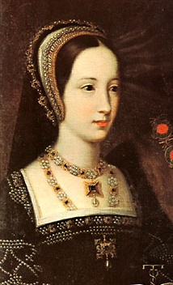
Mary Tudor and the Return to Catholicism
When Edward died, his half sister and daughter of Catherine of Aragon, Mary took over as queen.
Was determined to restore Catholicism to the national religion.
Many English citizens were against returning to the Roman Catholic Church.
Began persecuting those that attempted to remain faithful to Anglican Church.

Slide 4
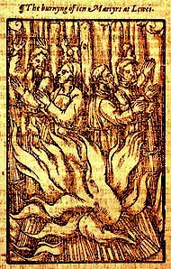
Marian Persecutions
Of those that remained faithful to the Church of England, many of the rich chose a life of exile.
However, in order to make a point, Mary had many imprisoned, quickly tried, and then executed.
In all total, nearly 800 left England to continue Protestant worship.
Nearly 300 were burned at the stake over a period of about 4 years.
This earned Mary the nickname, Bloody Mary.

Slide 5
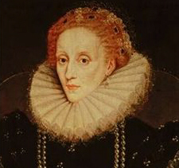
Elizabeth I: Queen of Compromise
After Mary’s death in 1558, her imprisoned sister, Elizabeth I became queen.
Daughter of Ann Boleyn, Elizabeth reinstated the Anglican Church, but did so in a way as to not anger many Catholics
Preserved many Catholic rituals, along with the hierarchy
Did not refer to herself as the Supreme Head of the Church.
Reinstituted the Book of Common Prayer.
Replaced Latin with English during services
These actions appeased both Catholics and Protestants, and allowed Elizabeth to end religious turmoil in England.

