Slide 1
Feudalism and the middle ages

Slide 2
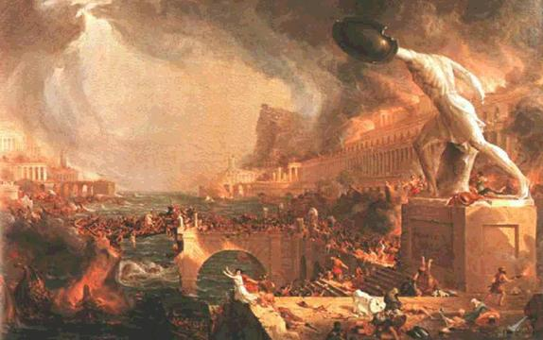
The Fall of Rome
The Roman Empire had spread to cover most of Western Europe, Northern Africa and the Middle East.
This however, spread the Roman military too thin, and forced them to give up many of the areas they had once conquered.
Eventually, continued fighting, especially with Germanic tribes of central Europe, led to Rome’s demise.

Slide 3
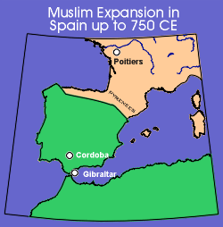
Europe After Rome
Without the protection of the Roman Army, the Europeans were left to fend for themselves.
Left them susceptible to invasion from such groups as the Vikings, Saxons, Muslims and Magyars.

Slide 4
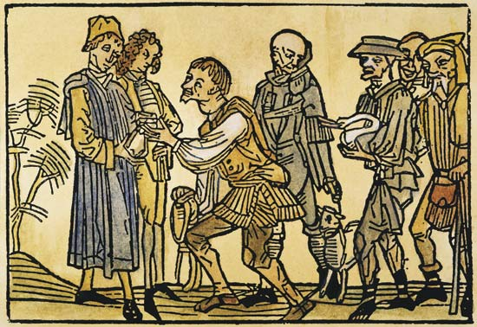
The Beginnings of Feudalism
To seek protection from these type of invasions, people would often enter into work agreements with local, powerful people, called lords.
This became the economic/social system for most of Europe during the Middle Ages.

Slide 5
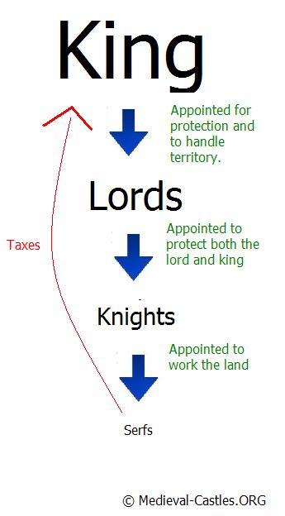
Feudalism
Feudalism was an oppressive economic system.
King would grant large land masses to lords in exchange for a share in the profits.
Lords would then grant smaller land masses , called a fief, to a lesser lord or vassal, in exchange for their military service.
Vassals and lords alike would grant average people , called serfs, protection in exchange for their work on farms

