Slide 1
Hinduism and Buddhism
Cultural traditions of classical India

Slide 3
Vedas
Original list of Hindu poems, hymns, prayers and rituals
Compiled by Brahmins and transmitted orally
Were not written down until 600 B.C.E. in Sanskrit
Mostly, these provided a look into the ancient past of Indian Civilization
Patriarchal society
Brahmins’ role was to practice ritual sacrifices that gave them power and wealth

Slide 4
Upanishads
Mystical and philosophical works that developed in response to dissatisfaction with Brahmins
Composed between 800 and 400 B.C.E.
Probed the inner meaning of Vedic (predecessor to Hinduism) sacrifices
Main idea: Brahman (the World Soul) is the ultimate reality
Atman, the individual human soul, is a part of Brahman
Goal was moksha union of atman with Brahman
Achieving this took many lifetimes
Samsara: reincarnation or rebirth process
Karma governs samsara

Slide 5
Hinduism and Gender
Women were increasingly forbidden to learn Vedas and participate in public rituals
Law of Manu defined women as beholden to men in every phase of life
Sexual pleasure was a legitimate goal for men and women as detailed in the Kamasutra
Many Hindu deities were female

Slide 6
Buddhism
Developed side by side with Hindusim
Siddhartha Guatama
Conducted spiritual journey at age 35 that led to “enlightenment” under the Bodhi tree
Followers saw him as the Buddha

Slide 7
Central Buddhist teachings
Life is suffering
Sorrow’s cause is craving for individual fulfillment, attachment to self
Cure it with modest and moral life and meditation
Goal is to achieve Nirvana (Enlightenment): extinguishing of individual identity

Slide 8
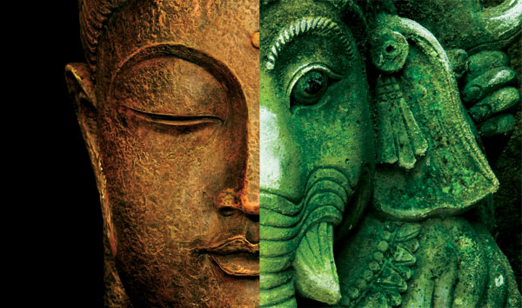
Similar beliefs between Hinduism and Buddhism
Life on earth is an illusion
Karma and rebirth
Our duty is to overcome the demands of the ego
Practice Meditation
Hope for Release from cycle of rebirth

Slide 9
Buddhism challenges Hinduism
Rejected Brahmins’ religious authority
Individuals should take responsibility for their own spiritual development
Challenged inequalities of Caste system

