Slide 1
Introduction to Empires
The Persians and Greeks

Slide 2

What is an empire?
Put simply, an empire is a political system with coercive power.
  Conquer other states
  Use their resources (land, people, minerals)
  Usually include multiple groups of people

Slide 3
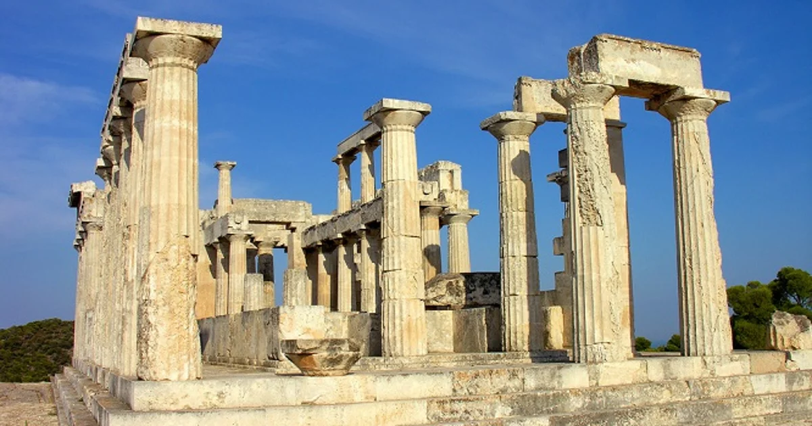
Second wave civilizations
Second Wave Civilizations
  Term used to describe civilizations formed from 500 B.C.E.-500 C.E.
  Includes multiple large empires that did not normally encounter each other directly with one notable exception, Greece and Persia

Slide 4
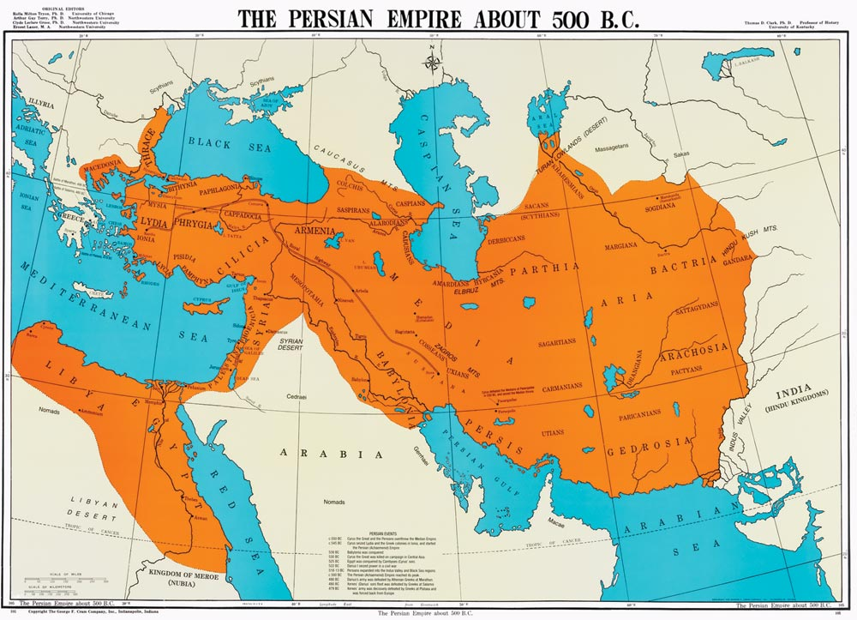
Persian Empire
Persian empire was the largest and most impressive empire in 500 B.C.E.
  Persians were Indo-Europeans that began with a homeland on the Iranian plateau
  Imperial system was crafted after attempts prior to this era in Mesopotamia
  Cyrus (557-530) and Darius (522-486) both expanded empires that expanded from Egypt to India
  Very large empire with population between 35-50 million

Slide 5
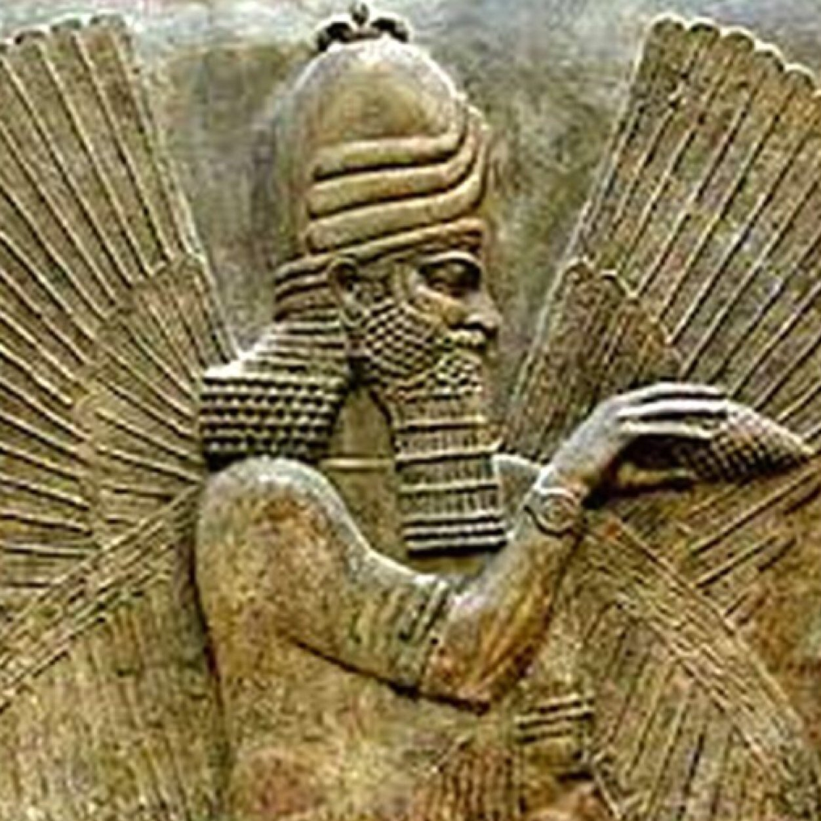
Persian Empire: Cult of Kingship
Rule was said to be determined b the god Ahura Mazda
  Absolute Monarchy
  Ruled through coercion and was more than willing to crush rebellious regions

Slide 6
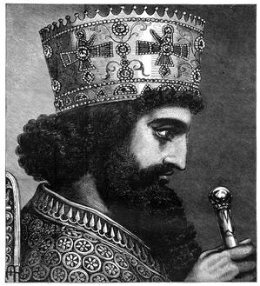
Persian Empire: Maintaining the Empire
For any empire, maintenance can be a problem, but Persia did have some success
  Government administration was efficient and effective
  Maintained respect/tolerance of non-Persian cultural traditions
  Standardized coinage
  Encouragement of communication and commerce
  Elaborate and effective irrigation system allowed thriving to farm in Middle East and beyond.

Slide 7
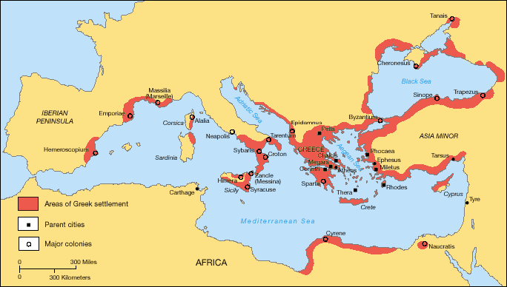
The Greek Empire: Basic Info
Classical Greece emerged around 750 B.C.E.
Flourished for about 400 years
Characteristics of Greek Empire
  Population of Greece and the Aegean basin was 2-3 million people
  Geography of mountains, valleys and islands encouraged the development of hundreds of city-states
  Shared a common language and common gods
  Between 750-500 BCE Greece began to colonize around the Mediterranean basin and Black Sea

Slide 8
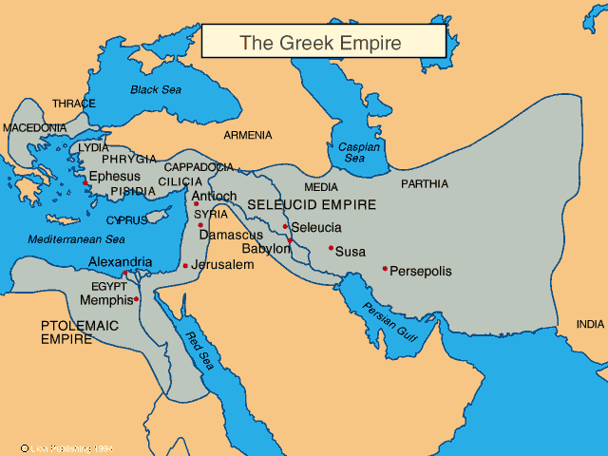
Greek Empire: Government and society
What separates Greece from other empires is the participation of more people in political life of city-states
  Equality of all citizens under the law
  Citizenship would vary depending on city-state and time
  Tyrants (dictators) would arise and were often supported by the poorer classes against the rich
  Sparta: gave power to a Council of Elders
  Athens: birthplace of democracy

