Slide 1
Paris peace conference and the treaty of versailles

Slide 2
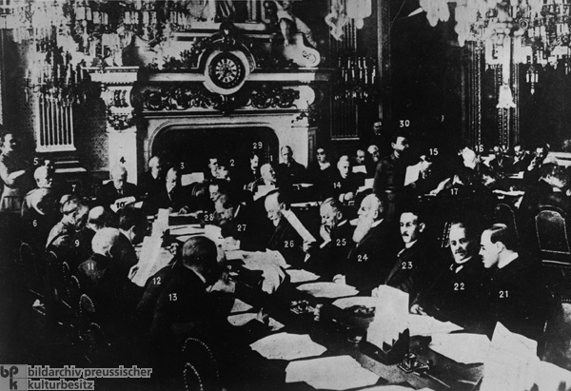
Paris Peace Conference
Leaders of the Allied Powers met to discuss the fate of the Central Powers and their colonies.
Neither the Central Powers nor Russian leaders were invited.

Slide 3
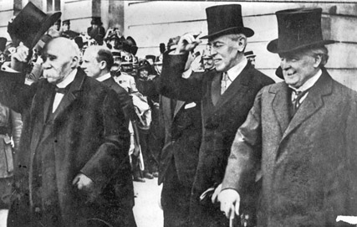
The Big Three and Their Goals
Major leaders from the Allied countries were known as the Big Three, and each had different goals
David Lloyd George, Britain, wanted to improve Britain’s economy with funding from Central Powers
Georges Clemenceau, France, wanted to weaken Germany to the point that is would never again be a threat to France.
Vittorio Orlando, Italy, wanted the southern lands of Austria Hungary promised them via a secret treaty.

Slide 4
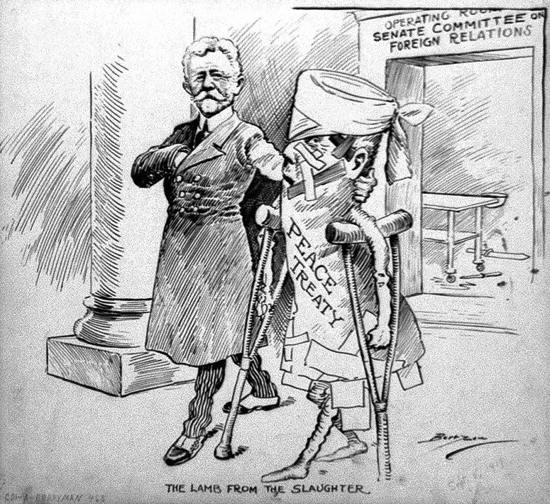
Treaty of Versailles
June, 1919, the allies ordered representatives of the new German Weimar Republic to sign the Treaty of Versailles.
Stated Germany was to assume full responsibility for the war
Reparations: Germany would have to pay the Allied powers for damage (averaged out to nearly $2.7 trillion dollars today)
Germany’s military was limited in size.
Alsace-Loraine was returned to France

Slide 5
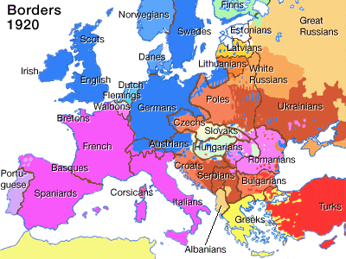
New Nations Formed
Poland became an independent state after nearly 100 years of foreign rule
Latvia, Lithuania and Estonia get independence
Czechoslovakia is formed
Austria and Hungary become independent nations

