Slide 1
Printing Press and Protestant Reformation

Slide 2
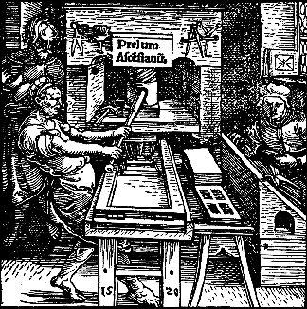
The Printing Press
Johann Gutenberg
1455 printed first edition of the Bible using printing press
Before printing press, only a few thousand books existed in Europe.
Why? They were all hand copied.
By 1500, 15-20 million had been produced

Slide 3
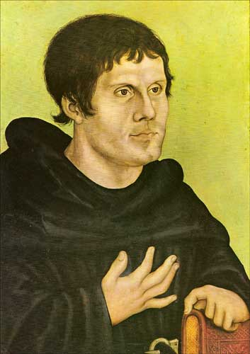
Martin Luther
Martin Luther: German monk who prided himself on living the Christian/monk lifestyle.
Though Luther was a part of the Church, he often observed and privately wrote on aspects of its actions that seemed contradictory.

Slide 4
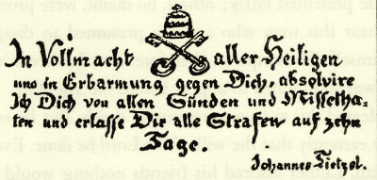
Johan Tetzel and Indulgences
Due to the ongoing costs being brought forth on the Church to rebuild St. Peter’s Cathedral, a German clergyman opted to sell indulgences
These guaranteed purchasers access to Heaven and removed their deceased relatives from Purgatory.

Slide 5
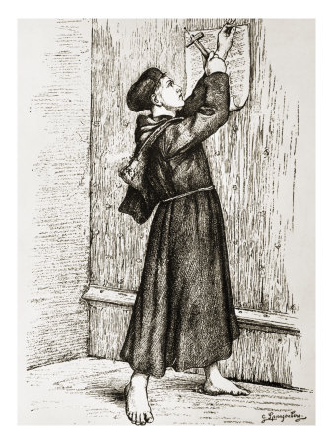
95 Theses
This action by Tetzel became the last straw for Luther.
He then composed his 95 Theses, and, as was common in the era, most likely nailed them to the door of the church.
These stated:
Indulgences had no basis in the Bible
Salvation was to come only through faith
Pope had no authority to release souls from Purgatory

Slide 6
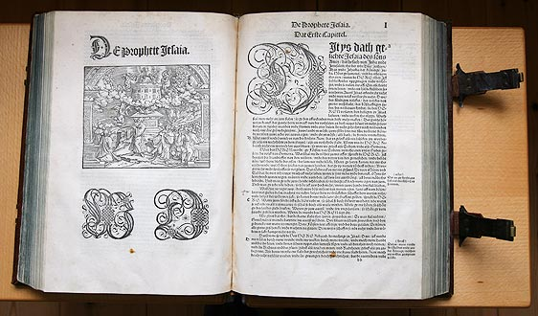
Luther’s Writings and Teachings
As word of this “rebellion” towards the church spreads, many of Luther’s writings quickly find their way through Europe.
Luther’s new Christian concepts include:
Salvation only achieved through faith
Sacraments can not erase sin
The Bible is the key to knowing how to achieve salvation

Slide 7
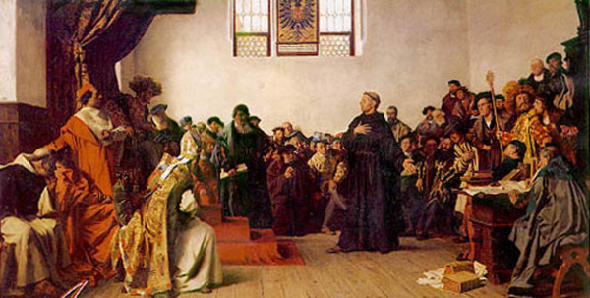
Reaction
As Luther’s teachings spread, he is called upon to testify at the Diet at Worms.
Pope Charles V orders Luther to recant, or state that his earlier teachings were not true.
Luther refuses and the Pope orders it a sin to provide Luther with any food or shelter.

Slide 8
Assignment
What impact did the work of Johan Gutenberg have on the Protestant Reformation?
Create an annotated outline of your ideas.
I. Argument
II. Support
A. Reason 1
III.
IV.
V. Conclusion

