Slide 1
Sand Roads
Exchange Across the Sahara

Slide 2
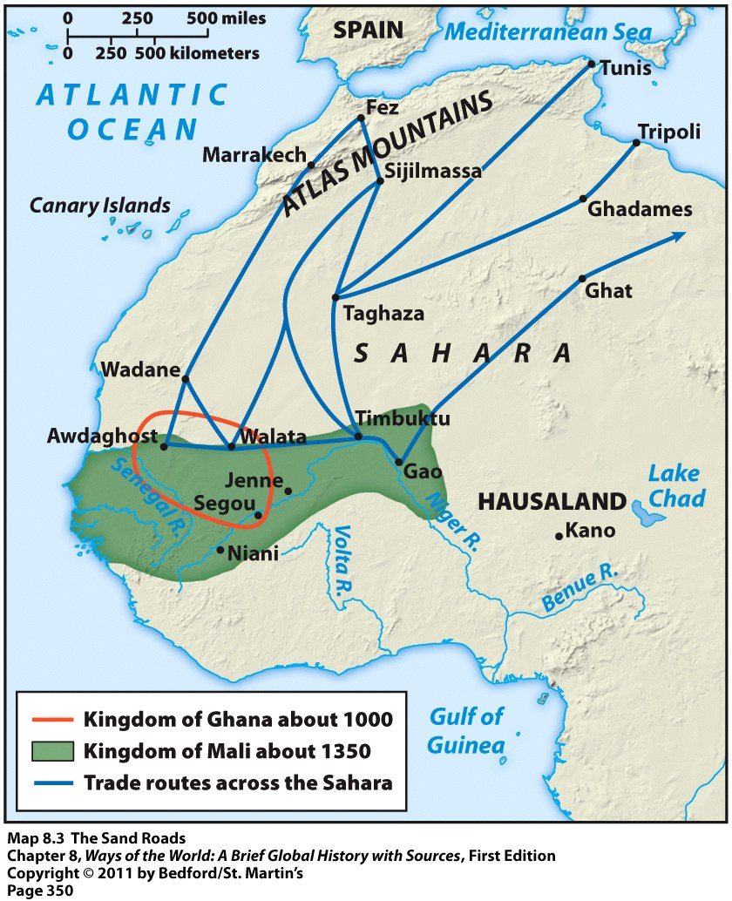
Roots of West African Trade
Trans-African trade was based on environmental variation.
  North Africa manufactured goods
  Sahara had copper and salt deposits; dates
  Agricultural people further south grew crops, produced textiles, mined gold

Slide 3
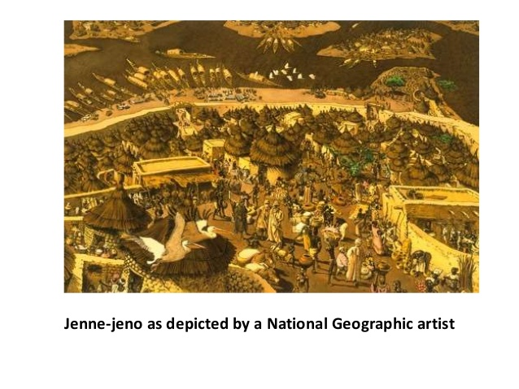
Early Trading in West Africa
Earliest trade in the region was among agricultural peoples in the Sudan
  Emergence of urban clusters in the early centuries C.E.
  Most famous was Jenne-jeno (a Niger Valley Civilization)

Slide 4

Camels Increase Trade in West Africa
Introduction of the camel in early centuries C.E. was a turning point
  Camels can go 10 days without water
  Made it possible to cross the Sahara
  Regular trans-Saharan trade by 300-400 C.E.

Slide 5
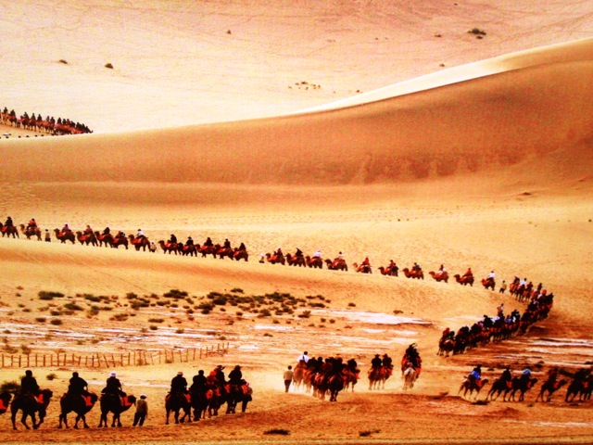
The Sahara as an International Trade Route
Merchants especially wanted gold from West Africa as well as ivory, kola nuts, slaves.
Huge caravans (as many as 5,000) camels traveled the desert for over 1,000 years

Slide 6
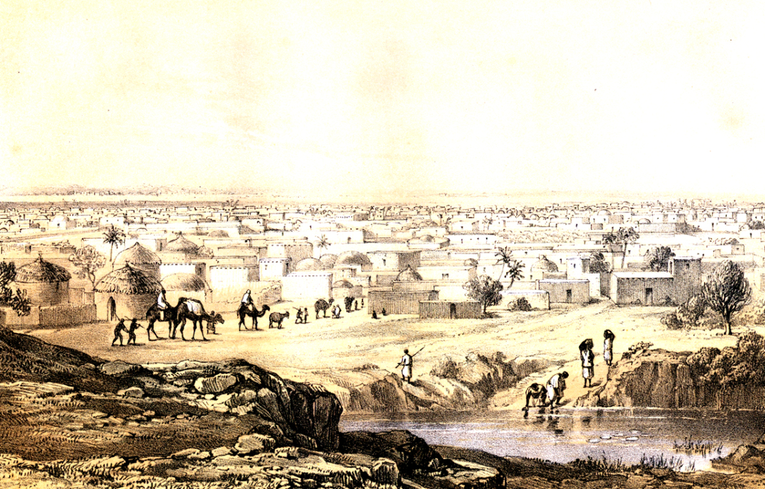
Impact on Politics
Trade encouraged new and larger political structures
  A series of states in western and central Sudan are created between 500 and 1600 C.E.
    Ghana, Mali, Songhay, Kanem and Hausa city-states
    All were monarchies with elaborate court life and military forces
    All had a reputation for wealth

Slide 7
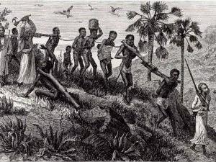
Slavery
Slavery was present in West Africa
  At first, most slaves were women
  With development of civilization, male slaves were sued as officials, porters, craftsmen, miners, agricultural laborers
  Most slaves came from societies raided farther south
  Around 5,500 slaves a year came across the Sahara between 1100 and 1400 C.E.

Slide 8
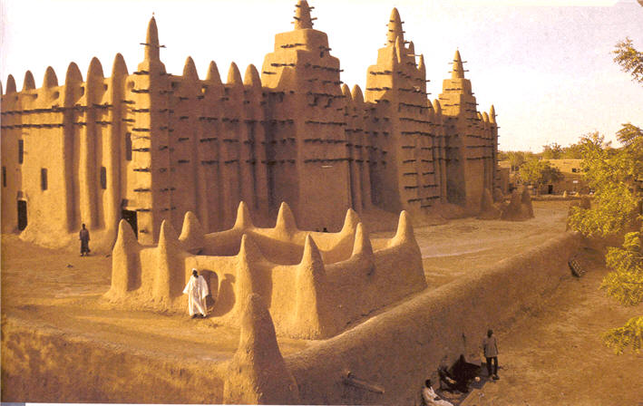
Social Impact of trade
Substantial urban/commercial centers form; Jenne, Timbuktu
  Some become manufacturing centers
  Islam was established in towns

