Slide 1
Sea Roads
Exchange Across the Indian Ocean

Slide 2
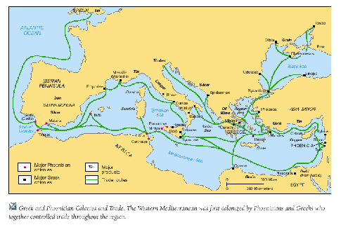
Beginnings of Eurasian Sea Trade
Mediterranean Sea was an avenue for commerce from the time of the Phoenicians
  Venice was a center of commerce by 1000 C.E.
  Controlled Trade of Imports from Asia
  Linked Europe to what would become a much greater trade network of the Indian Ocean

Slide 3
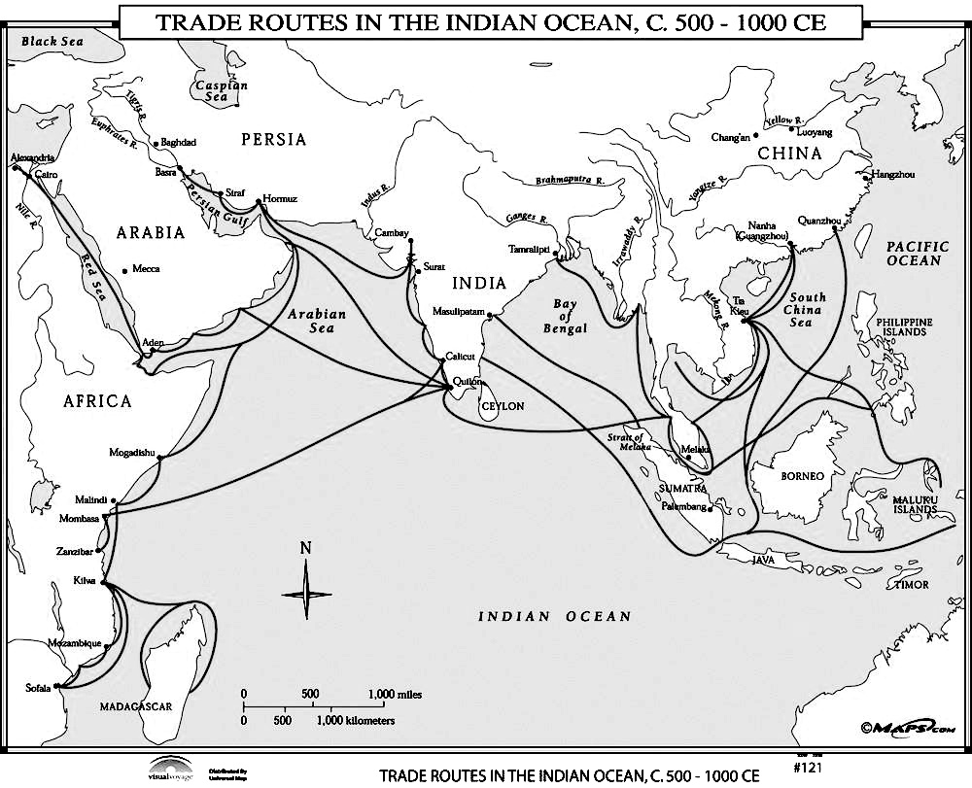
Significant trade on Indian Ocean
Indian Ocean network was the world’s most important until after 1500
  Trade grew from environmental and cultural diversity among 3 continents
  Transportation was cheaper by sea than land
  Made transportation of bulk goods possible (textiles, pepper, timber, rice, sugar, wheat)
  Commerce was possible thanks to alternating winds currents
  Commerce was often between towns and not states/governments

Slide 4
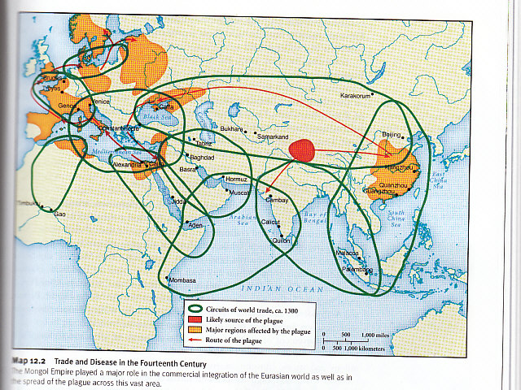
Origins of the Indian Ocean trade
Started in the age of the First Civilizations
  Indus Valley writing may have been stimulated by cuneiform
  Ancient Egyptians and Phoenicians traded down the Red Sea
  Malay sailors reached Madagascar in the first millennium BCE

Slide 5
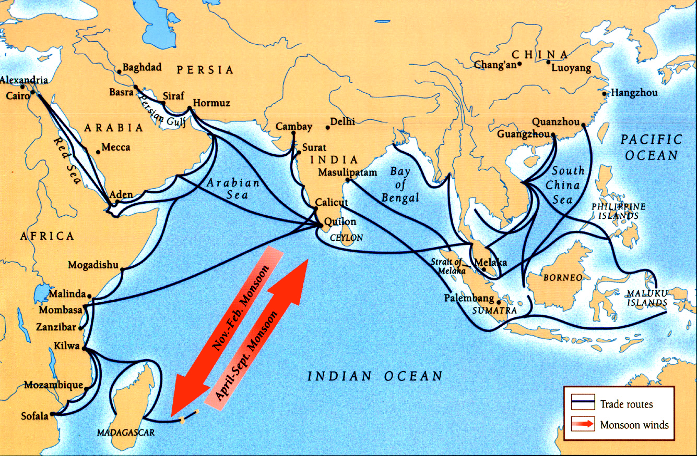
Growing Trade on the Indian Ocean
Tempo of commerce increased in early centuries C.E. with greater understanding of seasonal monsoons
  Merchants from Roman Empire settled in Southern India and East African coast
  Growing trade in eastern Indian Ocean and South China Sea
  Center of all of the trade was India
  Economic and political revival of China
  Rise of Islam in seventh century C.E.

