Slide 1
Silk roads
Exchange Across Eurasia

Slide 2
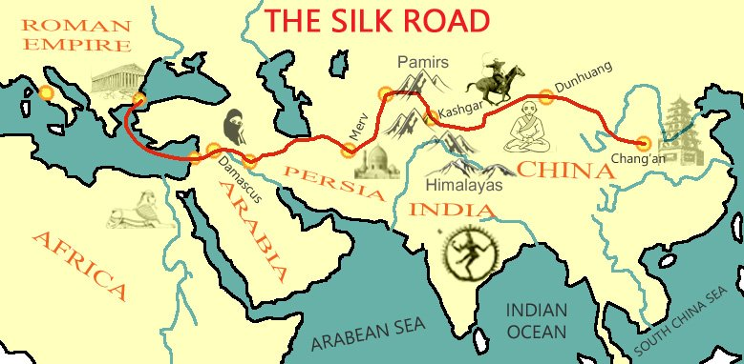
The Silk roads
One of the world’s most extensive and sustained networks of exchange
  Largely a relay trade
  Provided unity and coherence to Eurasian history

Slide 3
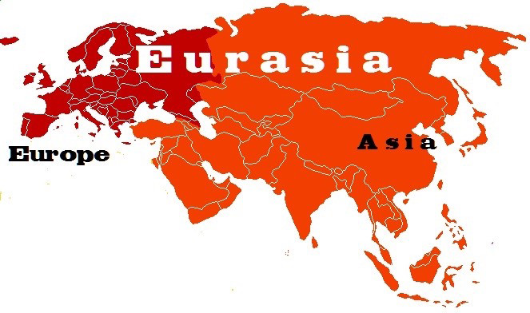
Ecologies of Eurasia and the silk Road
Eurasia is basically divided into inner and outer zones
  Outer Eurasia: relatively warm, well watered (China, India, Middle East, Mediterranean)
  Inner Eurasia: harsher climate, drier, mostly pastoral societies.
Why does this matter?
  Outer Eurasia will be more successful in agriculture, with a migrating group in between.

Slide 4
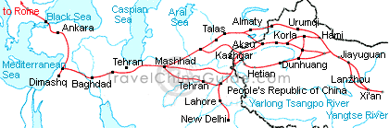
Growth of the silk roads
Creation of Second Wave civilizations and imperial states in the last 5 centuries B.C.E. included efforts to control pastoral societies
  Trading networks did best when large states provided security for trade
  Roman and Chinese Empires became a catalyst and anchor for commerce/trade
  In 7th and 8th Centuries the Byzantine Empire, Abbasid dynasty and Tang dynasty created a belt of strong states
  In 13th and 14th centuries, Mongol Empire controlled entirety of Silk Roads

Slide 5
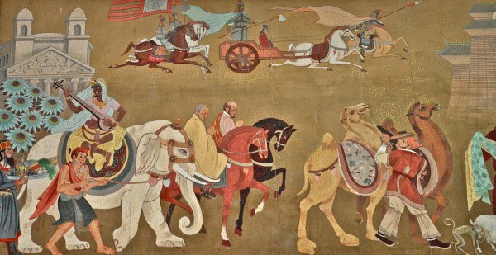
Trading Goods
Vast array of goods traveled along the Silk Roads, often by camel
  Mostly luxury goods for the elite
  High cost of transport did not allow movement of staple goods

Slide 6
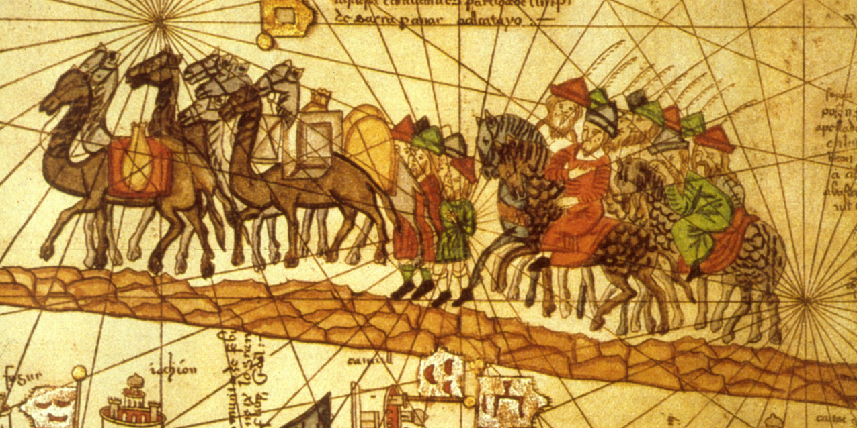
Trading Goods: Silk
Silk symbolized the Eurasian exchange system
  At first, China had a monopoly on silk technology
  By 6th century C.E., other groups were producing silk
  Silk was used as currency in Central Asia
  Silk was a symbol of high status
  Silk industry only developed in Western Europe in 12th century

Slide 7
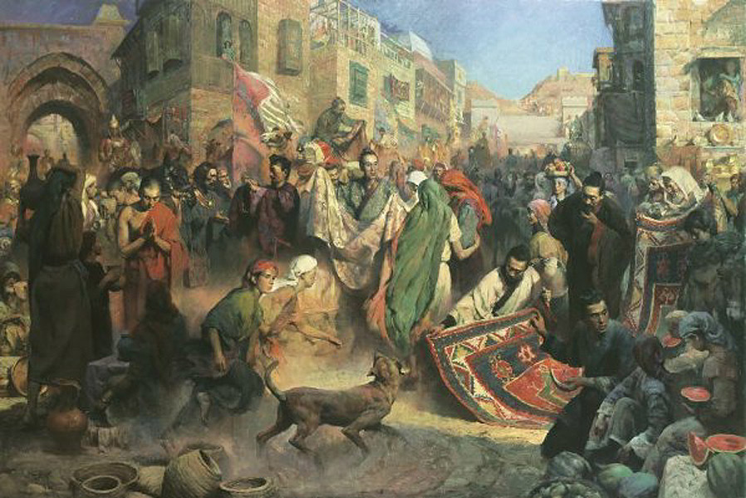
Trading Goods: The System
Volume of trade was small, but of economic and social importance
  Peasants in Yangzi River delta of southern China produced market goods (silk, porcelain, et cetera) instead of crops
  Well placed individuals could make enormous profits
    Buy low from peasant artisans and sell high to merchants, other traders and wealthy elite.

Slide 8
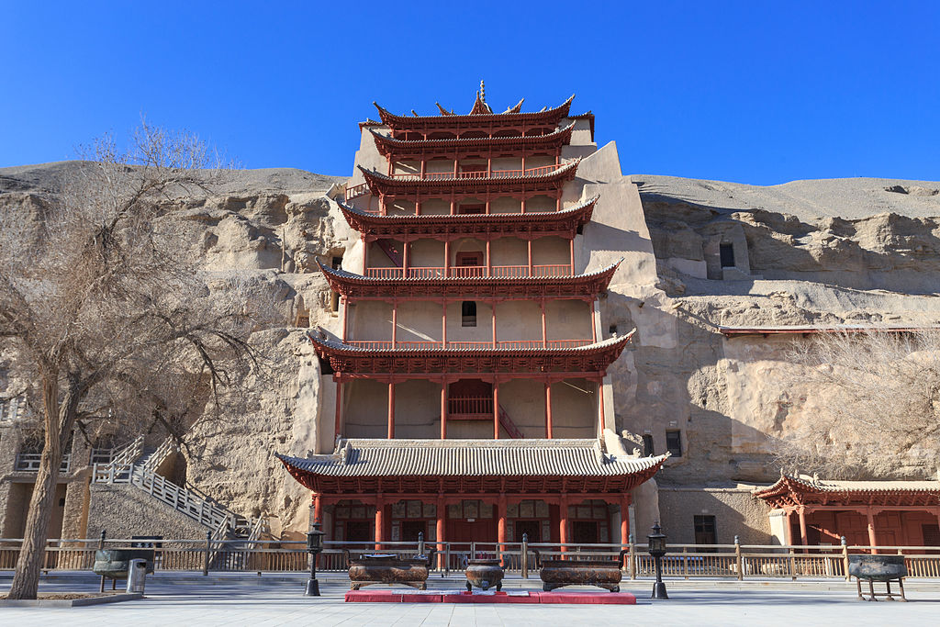
Trading Cultures
Cultural transmission perhaps more important than exchange of goods
Example: Buddhism
  Spread along Silk Road through Central and East Asia
  Had always appealed to merchants
  Heavy conversion in somewhat isolated cities in Central Asia
  Many Central Asian cities become centers of learning and commerce
    Buddhist texts and cave temples of Dunhuang
  Buddhism spreads more slowly among Central Asian pastoralists
  In China, Buddhism was the religion of foreign merchants or rulers for centuries
  Buddhism was transformed during its spread

Slide 9
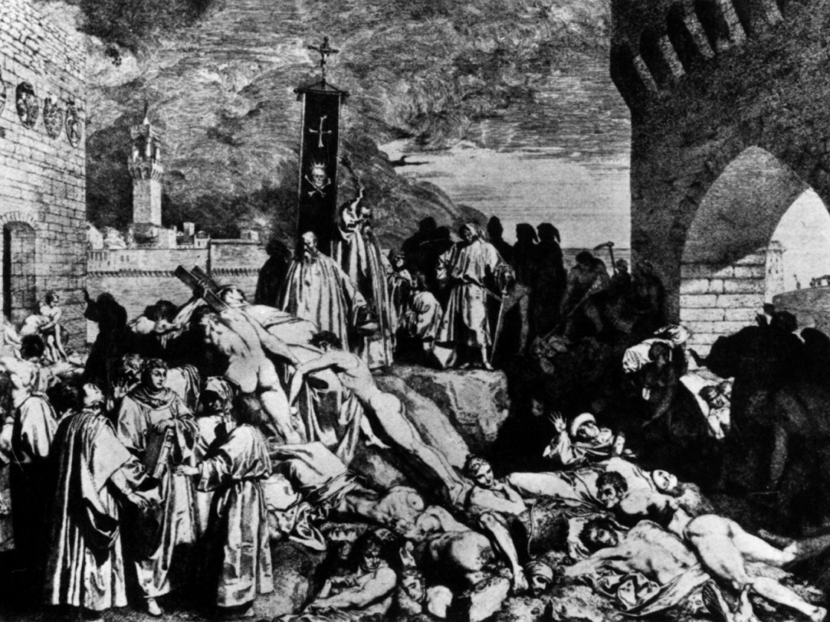
Trading Disease
Major population centers of Afro-Eurasian world developed characteristic disease patterns and ways to deal with them
But, long distance trade means exposure to unfamiliar diseases
  Early case: epidemic in Athens 430-429 B.C.E.
  During Roman and Han empires, smallpox devastated both populations
  534-750 C.E., bubonic plague from India ravaged Mediterranean world

Slide 10
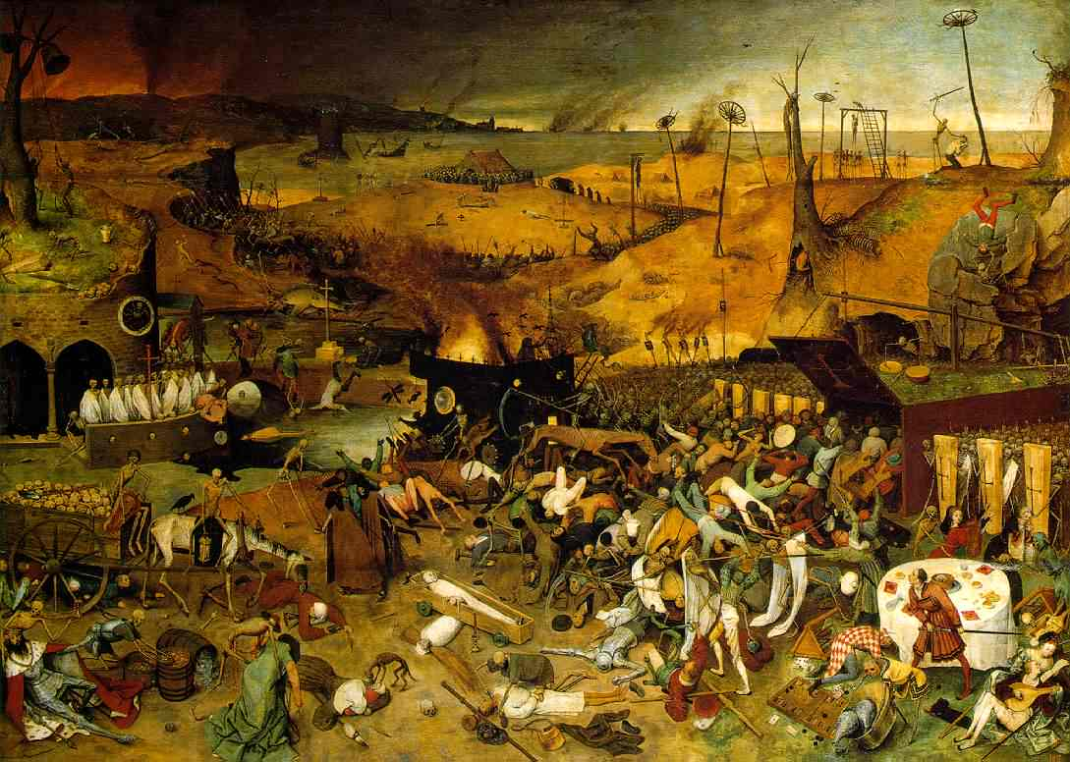
Trading Disease: The Black Death
Black Death spreads mostly due to Mongol Empire’s unification of much of Eurasia 13th-14th centuries
  Mixture of bubonic plague, anthrax, or collection of epidemic diseases
  Killed as much as ½ of European population between 1346 and 1350
  Similar death toll in China and parts of the Islamic world
However, this exchange of diseases gives Europeans their greatest weapon in their expansion to the Western Hemisphere after 1500

