Slide 1
Slavery of Second Wave Civilizations

Slide 2
Why did slavery emerge in the first place?
There are several theories:
  Domestication of animals provided a model for human slavery
  War, patriarchy and private property ideas encouraged slavery
  Large-scale warfare contributed to the growth of slavery
  Patriarchal “ownership” of women may have encouraged slavery.

Slide 3
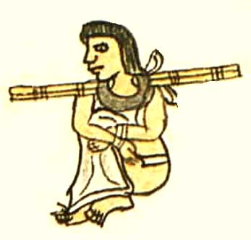
Tradition of Slavery
Slavery was a long established tradition by the time of Hammurabi (around 1750 B.C.E.)
Almost all civilizations had some form of slavery, but format and terms varied:
  Classical Greece and Rome experienced frequent slave emancipaiton
  Aztec Empire: children of slaves were considered to be free

Slide 4
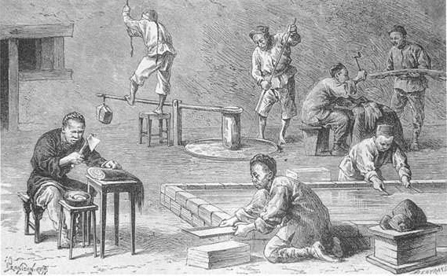
Slavery in Asia
Slavery was less common in China
  Maybe 1% of populaiton
  Convicted Criminals and their families were the earliest slaves
  Poor peasants sometimes sold their children into slavery
Slavery in India
  Criminals, debtors, war captives were used as slaves
  Largely domestic
  Religion and law gave some protections
  Society wasn’t economically dependent on slavery

Slide 5
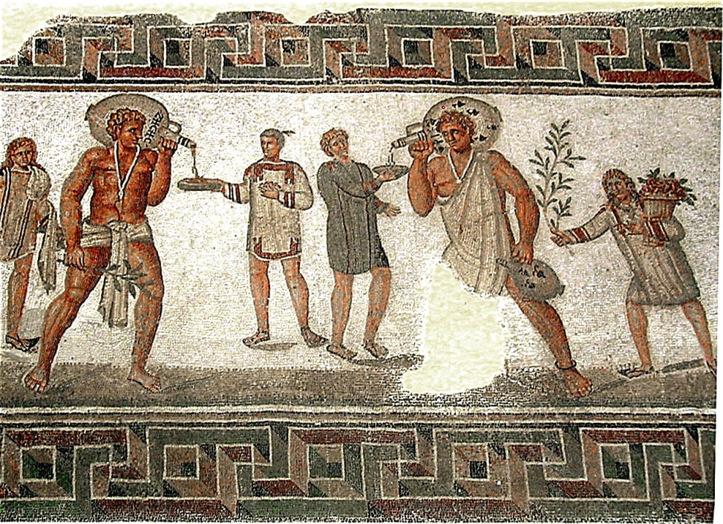
Slavery in Rome
Slavery played a much bigger role in Mediterranean/Western Civilizations
  Greco-Roman world was a slave society
  1/3 of Athens was enslaved
  Aristotle: some people are slaves by their nature

Slide 6
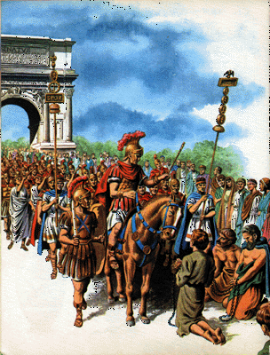
How People Became Slaves
33-40 percent of Italian peninsula were slaves
  Massive enslavement of war prisoners
  Piracy
  Long-distance trade for Black Sea, East African and northwest European slaves
  Born into slavery
  Abandoned children

Slide 7
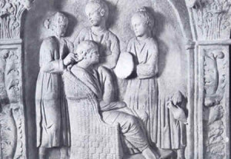
Characteristics of Roman Slavery
Not associated with a particular ethnic group
Very little social critique of slavery, even as Christianity becomes the main religion in Rome
Deeply entrenched in Roman society
  Slaves performed all levels of work except military service
Slaves had no legal rights
Manumission was common; freed slaves could become citizens

Slide 8
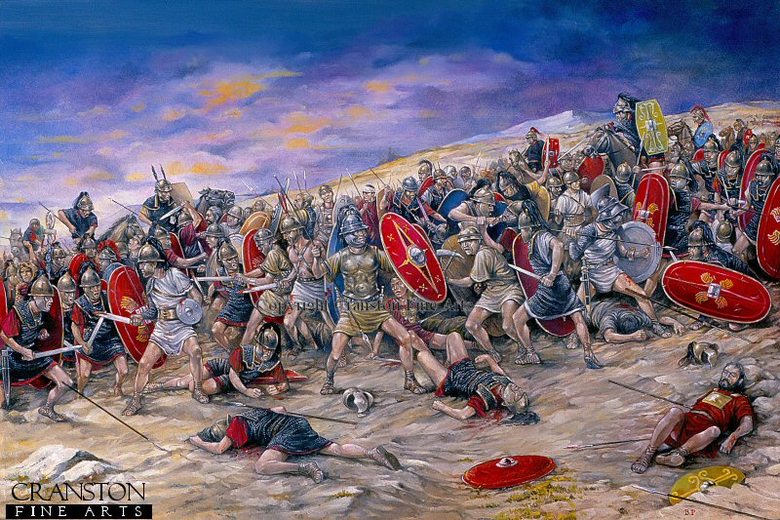
Resistance and Rebellion
Cases of Mass suicide of prisoners of war
“Weapons of the Weak”
  Theft, sabotage, poor work
Escape
Occasional murder of owners
Rebellion
  Spartacus

