Slide 1
Stalin and the Soviet Union
A Communist Totalitarian Government

Slide 2
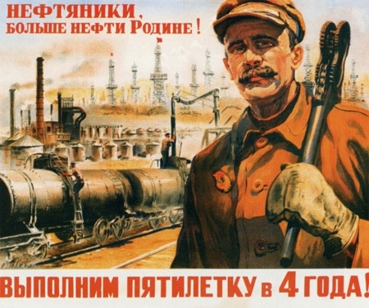
Stalin’s 5 Year Plans
Stalin claimed that Russia had suffered due to its economy being “backwards,” focusing on agriculture and not industry.
Once taking power, he implemented his 5 Year Plans.
Intended to force building of heavy industry
Government owned all businesses and distributed resources.

Slide 3
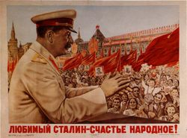
Positive Results of the 5 Year Plan
5 Year Plans set high production quotas
Factories/Managers that met those quotas were rewarded, those that did not were punished or imprisoned.
Factories produced in large numbers; mining expanded, increased steel production, built railroads.

Slide 4
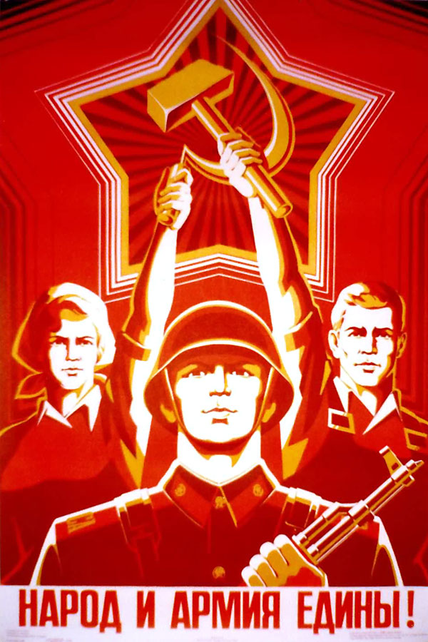
Negative Results of 5 Year Plans
Simply trying to meet quotas, many managers produced large quantities of low quality goods.
Central Planning, the government deciding on quantities to be produced led to shortages in some areas and surpluses in others.
Workers’ wages were low and they were forbidden by the government to strike.

Slide 5
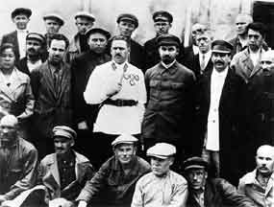
Collectives
Under Lenin’s New Economic Policy, farmers were allowed to keep some of their own land and farm for profit; this changed under Stalin.
Wanted all farmers to farm on state land or collectives.
Used to farming their own land, some protested this by burning crops, killing livestock considered property of the state.
Lenin referred to them as Kulaks, wealthy farmers.
He had them sent to labor camps or executed.

Slide 6
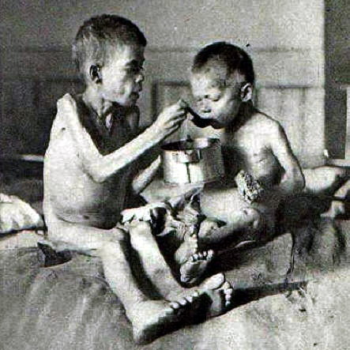
Stalin Puts Down Resistance
Angered by Stalin’s policies on farms, peasants began to protest.
Began to grow just enough to feed themselves.
Stalin’s Response
The government purposely seized all of their grain to meet industrial goals.
Left to starve with noting
Referred to as the Terror Famine, this led to the death of over 5 million people in the Ukraine alone.

Slide 7
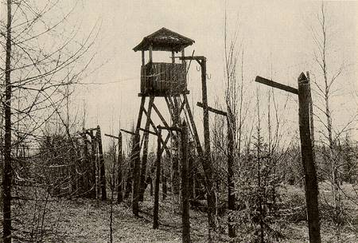
The Gulag
In order to ensure obedience, Stalin began using terror as a weapon
Used a system of secret police to spy on the people.
There was no freedom of speech or press
Dissenters were often rounded up and sent to the Gulag, a system of labor camp prisons

Slide 8
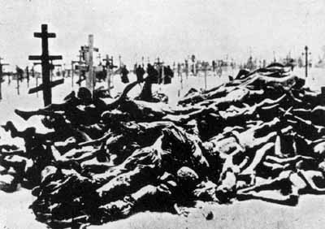
The Great Purge
Even with all of his power, Stalin still feared people were plotting against him.
1934 Stalin launches the Great Purge
Stalin and his secret police sent Old Bolshevicks, industrial managers, writers, etc. to the Gulag.
Some public trials were held, but people were often tortured to get a confession.
It is estimated that nearly 4 million people were sent to prison and eventually died during the Great Purge.

Slide 9
Stalin and Conformity
One of the main goals of Stalin’s regime was to get the Russian people to conform.
Propaganda including movies, billboards and posters depicted heroes of communism and the evils of capitalism.
Artists and authors were required to adhere to the style of socialist realism, creating art and literature that showed the positives of Soviet life.

