Slide 1
The Birth of Islam

Slide 2
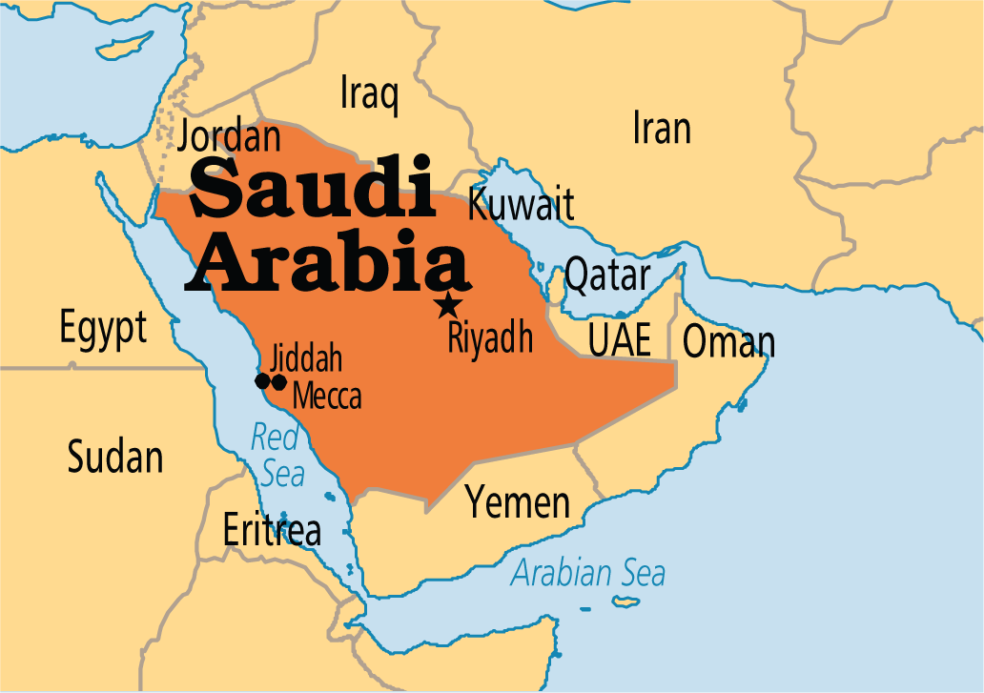
The Homeland of Islam
Unlike most religious/cultural traditions, Islam emerged from a marginal region, the Arabian Peninsula
Home of nomadic Arabs (Bedouins)
  Fiercely independent clans and tribes
  Originally had a variety of gods.
Arabia had sedentary agricultural areas as well
Arabia lay on important East-West trade routes
Arabia was on the edge of the Byzantine and Sassanid empires
  Arabs knew some practices of these empires
  Judaism, Christianity and Zoroastrianism had spread there among Arabs.

Slide 3
Muhammad Ibn Abdullah (570-632 C.E.)
The prophet of Islam
Orphaned at a young age
Became a prosperous merchant thanks to marriage to Khadija
Began to withdraw from society and meditate.
Began to have revelations from Allah in 610
  These were recorded in what would become the Quran
  When heard in its original Arabic, believed to convey the presence of the divine.

Slide 4
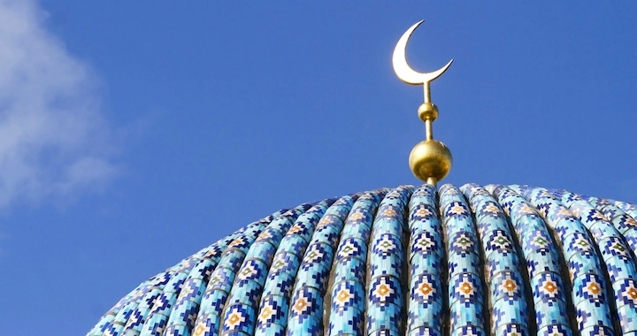
Teachings of Islam
Monotheism
Muhammad as “the seal of the prophets”
Return to the old, pure religion of Abraham (“founder” of Judaism)
Central message is submission to Allah (Muslim literally means “one who submits”)
Need to create a new society of social justice, equality and care for others; the umma.

Slide 5
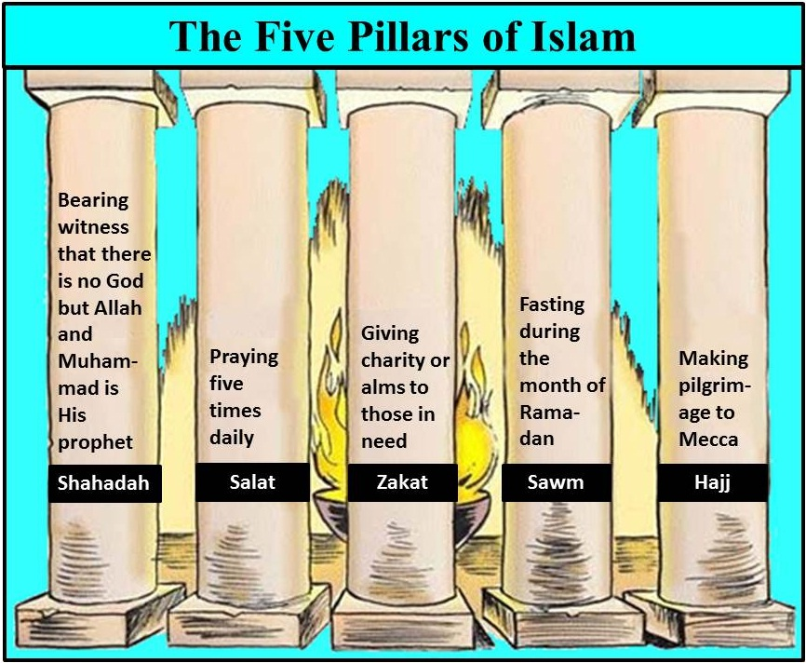
The Five Pillars of Islam
The core Islamic practices are broken down into the Five Pillars of Faith.
  Must profess “There is not god bug Allah, and Muhammad is his prophet.”
  Pray 5 times per day at prescribed times
  Give generously to help the community and the needy
  Fasting during the month of Ramadan
  Pilgrimage to Mecca; hajj

Slide 6
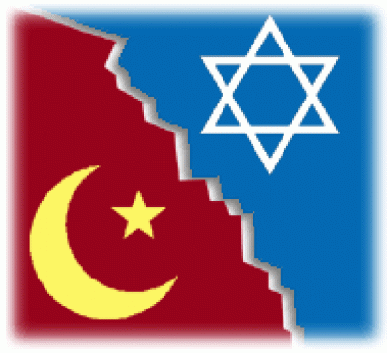
Muhammad’s Followers
Muhammad attracted a small following which would draw opposition from Meccan elites
  In 622, they emigrated to Medina; the hijra.
  Created an Islamic community (umma) in Medina
  Broke definitively from Judaism

Slide 7
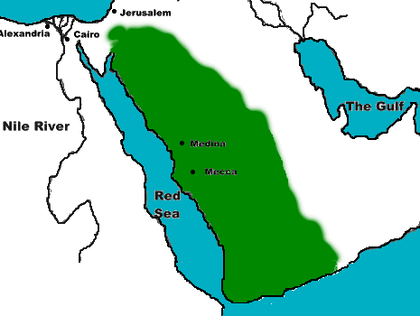
Early Spread of Islam
Rapid Expansion through Arabia
Military successes led to alliances
Begin periods of large-scale conversion
Consolidation of Islamic control throughout Arabia by time of Muhammad’s death in 632

Slide 8
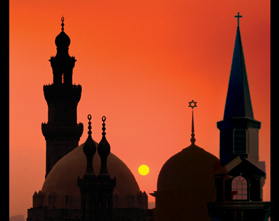
Comparing Islam and Christianity
There are fundamental differences between the births of Islam and Christianity
  Islam did not grow up as a persecuted minority religion
  Islam didn’t separate “church” and state

