Slide 1
The Bolshevik Revolution
Communism in Russia

Slide 2
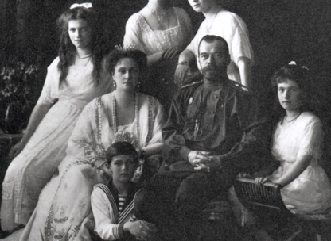
The Romanovs: ruling dynasty for 300 years, Absolute Monarchs

Slide 3
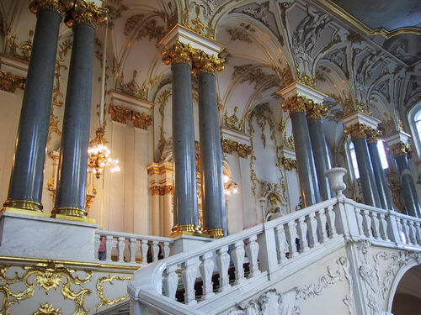
Catherine Palace
One of the Romanov’s several homes.

Slide 4
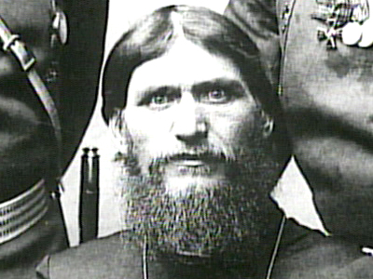
Gregory Rasputin
Advisor to the Romanovs. Became Alexander Romanov’s most trusted advisor.

Slide 5
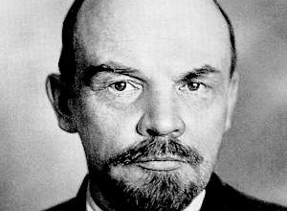
Vladimir Lenin
Communist Revolutionary that would eventually lead the Bolsheviks to rise up in Russia.

Slide 6
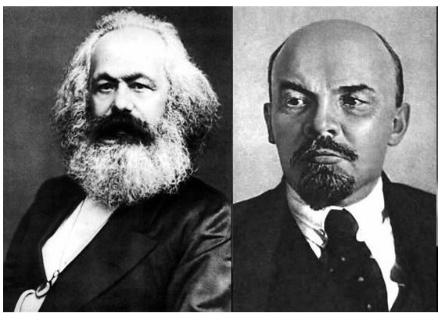
Lenin and Marx
Marx believed that the people would eventually take control, while Lenin believed that a small group needed to implement communist policy.

Slide 7
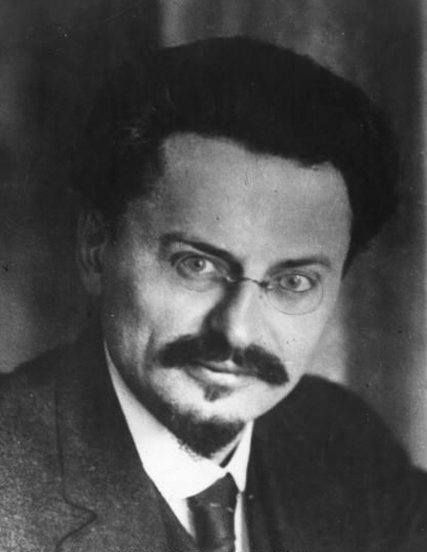
Leon Trotsky
Communist Revolutionary promising “Peace, Land and Bread”

Slide 8
Bolshevik Revolution
In November 1917, Red Guards joined with mutinous sailors to attack the provisional government. They took over cities, and eliminated the provisional government as well as the Romanov family.

