Slide 1
The Collapse of Empires

Slide 2
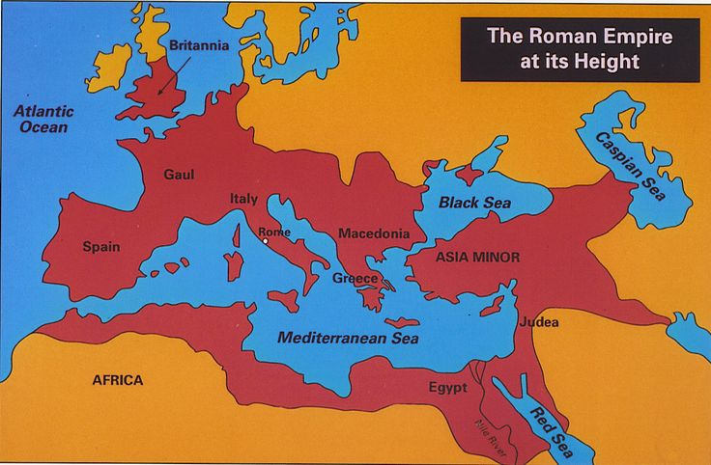
Common Factors in the Collapse of Rome and China
Excessive size and overexpansion make defending the empire too expensive and daunting a task.
No great technological breakthrough to enlarge the effect of the resources-Law of diminishing returns
Large landowning families, far away from the empire’s capital tend to avoid taxes
  Puts tax burden largely on the poor, which leads to discontent and occasional rebellion

Slide 3
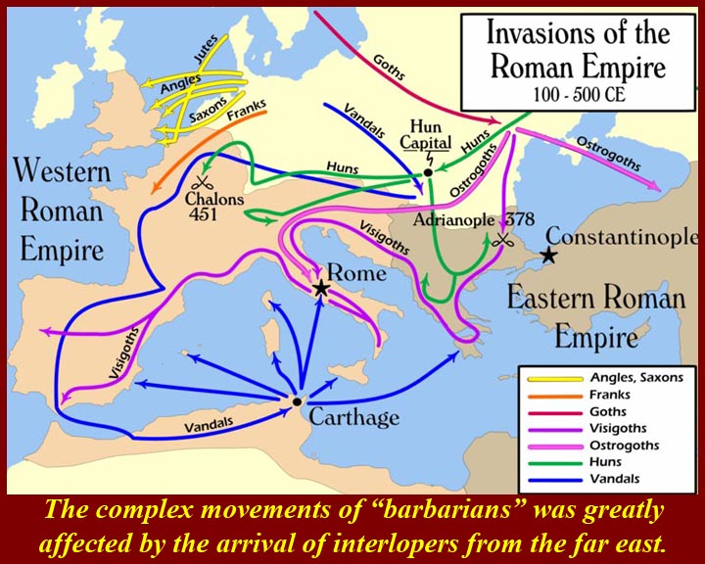
Common Factors, continued
Rivalries between elite factions, families, governors, et cetera create instability
Epidemic disease
Threat from nomadic/semi agricultural people on frontier
  China had more success assimilating invaders than Rome

Slide 4
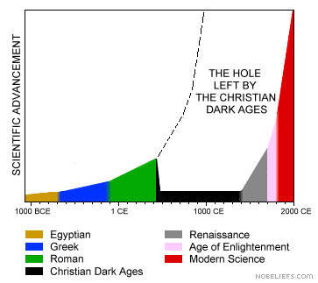
Effects of Imperial Collapse
Decline of urban life
Population decline
Reduction of international trade
Vast insecurity

Slide 5
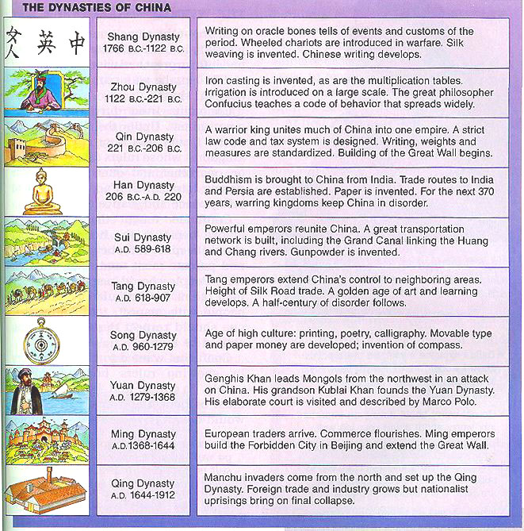
What happens next?
This is the major difference between Rome and China
  China: has about 350 years of disorder and fighting, then creates a similar imperial state that continues through the Sui, Tang, and Song dynasties
  Europe: no large-scale imperial system has ever been successfully established in western Europe since the Romans

Slide 6
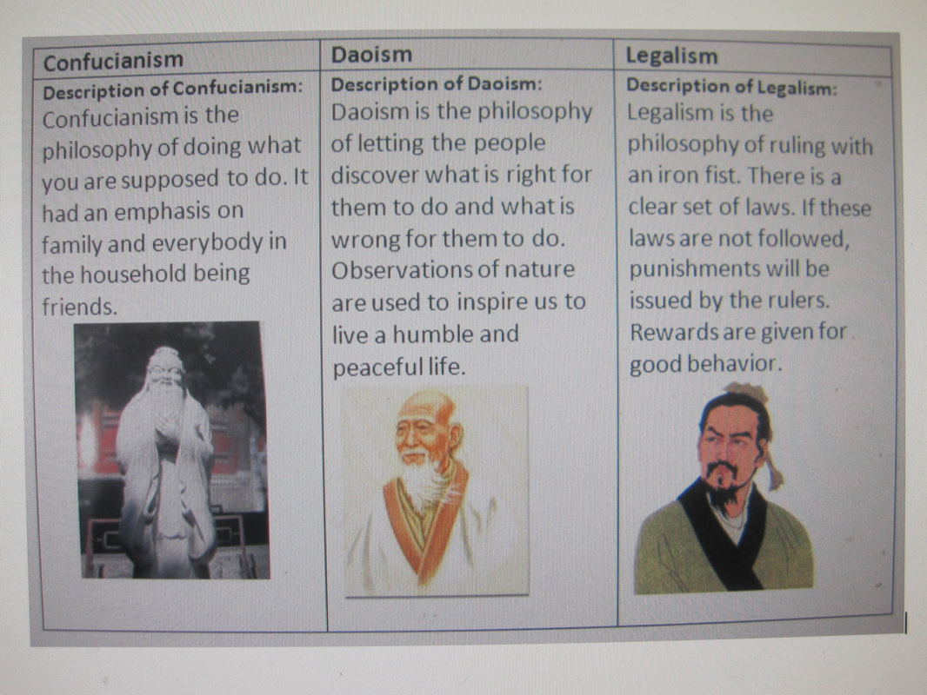
Reasons for Chinese Success in Rebuilding
Greater homogeneity
  Unlike Europe, most Chinese were ethnically and culturally the same.
Strong bureaucratic tradition
  People are used to laws and government practices
Confucianism
More productive agriculture
Metallurgy is more advanced
  Allows China to move towards better weapons for defense and reconquering

