Slide 1
The Indian Caste System and Inequality
Caste as Varna and Jati

Slide 2
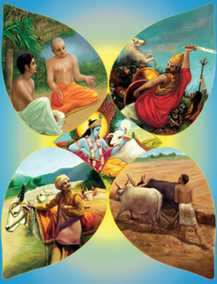
Roots of the Caste System
“Caste” actually comes from the Portuguese word meaning “race” or “purity of blood”
Most likely evolved from encounters between Aryans and natives
Economic specialization and culture apparently more important than notions of race.

Slide 3
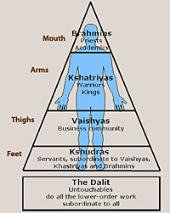
Caste as Varna
As early as 500 BCE, there was a clear belief that society was divided into four great classes (Varna)
  Three Segments of “twice born” Aryans (Brahmins, Kshatriyas, and Vaishyas)
  Sudras: native peoples that were to live in very subordinate positions

Slide 4
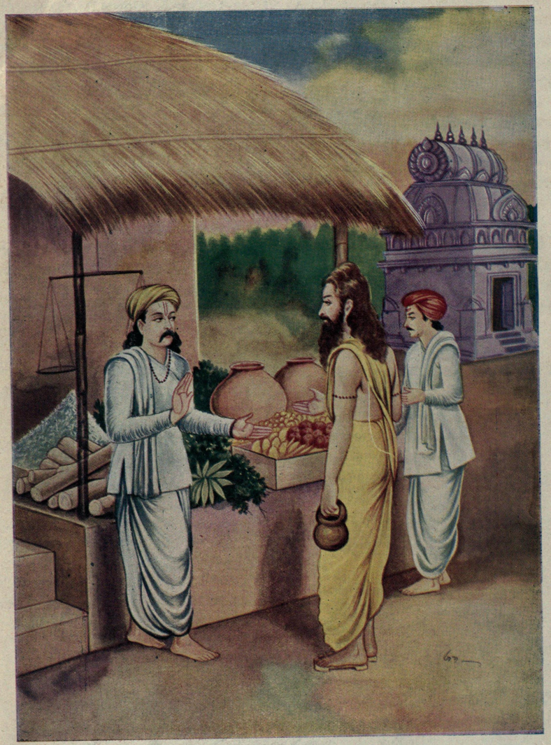
A changing system
Varna theory: the four groups were formed from the body of the god Purusha; and they were absolute.
  In reality, there was considerable change as economies changed.
  Always conflict between Brahmin and Ksatriya
  Vaisya evolved into the business class
  Sudra became present farmers
  Creation of untouchables under the Sudras

Slide 5
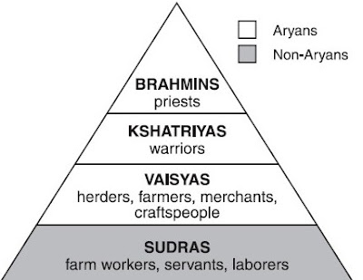
Caste as Jati
Social distinctions are based on specific occupations, organized as guilds (jatis)
  Blended with varna system
  Thousands of jatis formed and became the primary structure of social life
  Each of the 4 varnas were divided into several jatis

Slide 6
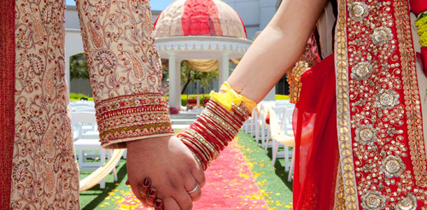
Jati and social position
Jati had clearly defined social position
  Marriage and eating together only permitted with individual’s jati
  Each jati had particular duties, rules and obligations

Slide 7

Inequality and Jati
Inherent inequality supported by idea of karma, dharma, and rebirth.
  Birth into a caste determined by good or bad deeds (karma) of a previous life
  Rebirth in a higher caste determined by performance of present caste duties
Threat of social ostracism for violating rules of the jati
Individuals couldn’t raise social status, but whole jatis could improve social standing.

Slide 8
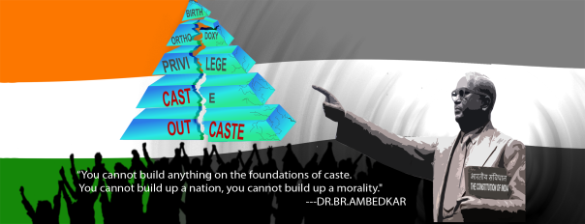
Functions of Caste
Caste was very local, so it focused loyalties on a restricted territory
  Made empire building difficult
  Caste as a substitute for the state
  Caste did provide some social security
    Care for widows, orphans, the destitute
  Made it easier for the wealthy and powerful to exploit the poor.

