Slide 1
The Philosophes

Slide 2
The Philosophes
French Philosophers
Believed that you could apply reason, logical thinking, to all aspects of life, not just science
Beliefs
Truth can be discovered by reason. Reason is the absence of intolerance, bigotry, or prejudice.
Nature is good and reasonable. Natural for humans, just as there are natural laws in nature
Society can be set free through reason

Slide 3
Famous Philosophes
Francois Marie Arouet- Voltaire
Criticized religion. He saw it as intolerant
Montesquieu- believed that the British government was the best because of how the power was divided.
His ideas became the basis for the idea of “Separation of Powers.”
“Power should be a check to power.”
Rousseau- Civilization corrupts people. Social contract- people give up power to kings, if kings misuse power, you have the right to rebel
“Man is born free, and everywhere he is in chains.”
Beccaria- People should receive a speedy trial, torture should not be used, and death penalty should be outlawed

Slide 4
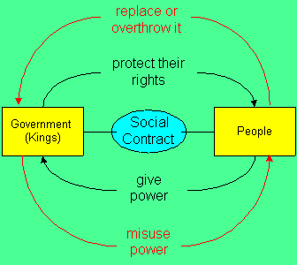
Social Contract

Slide 5
Voltaire- Quotes
Every man is guilty of all the good he didn’t do.
If God didn’t exist, it would be necessary to invent him.
It is dangerous to be right, when the government is wrong.
Love truth and pardon error.
Men are equal; it is not birth, but virtue that makes us different
I may not agree with you, but I will defend to the death your right to say it.

