Slide 1
The Reemergence of a Unified China
The Golden age of Chinese achievement

Slide 2
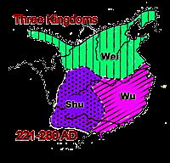
Collapse of Han Dynasty
Around 220 C.E.
Led to 300 years of political fragmentation
Conditions discredited Confucianism to many Chinese
Chinese migration southward to Yangzi River valley began

Slide 3
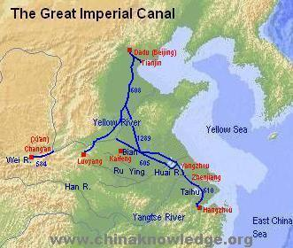
“Golden Age” of Chinese Achievement
Sui Dynasty (589-619) reunified China
  Sui rulers vastly extended the canal system
  Ruthlessness and failure to conquer Korea alienated people and exhausted state’s resources

Slide 4
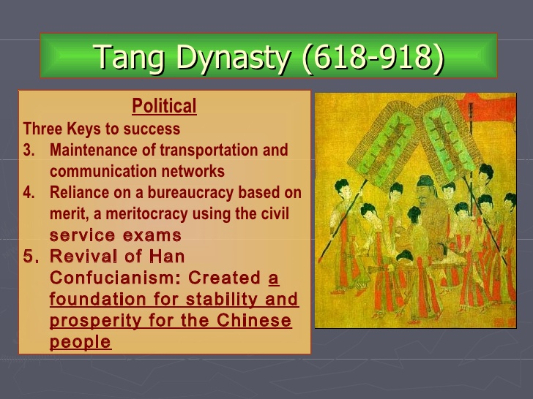
Tang (618-918) and Song (960-1279) Dynasties
Established patterns of Chinese life that lasted into the twentieth century
Regarded as a golden age of arts and literature
Politics
  6 major ministries created along with the Censorate for surveillance
  Examination system revived to staff the bureaucracy
  Proliferation of schools and colleges
  Large share of official positions went to sons of elite
  Large landowners continued to be powerful, despite state efforts to redistribute land to peasants

Slide 5
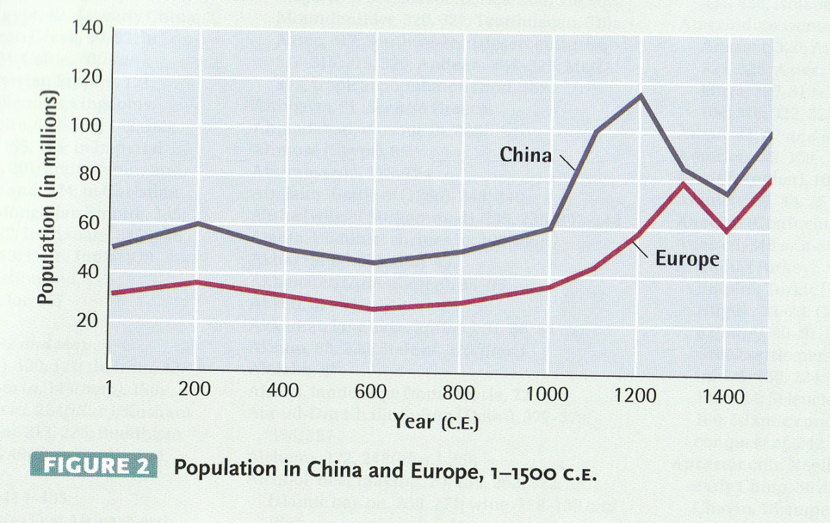
Economic Revolution Under the Song Dynasty
Period of great prosperity
Rapid population growth; from 50-60 million during Tang to 120 million by 1200.
Agricultural improvement
China was the most urbanized region in the world
Great network of internal waterways
Improvements in industrial production
Invention of print
Best navigational shipbuilding technology in the world
Invention of gunpowder

Slide 6
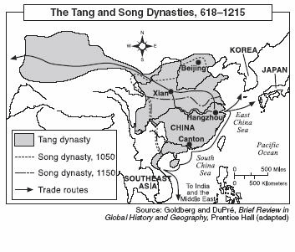
Trade Increases
Production for the market rather than local consumption
  Cheap transportation allowed peasants to grow specialized crops
  Government demanded payment of taxes in cash
  Growing use of paper money and financial instruments.

