Slide 1
Western Europe
Rebuilding in the Wake of Roman Collapse

Slide 2
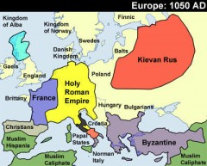
Decline of western Europe
After the fall of Rome, Western Europe was on the margins of world history for most of the third-wave millennium.
Far removed from the growing trade routes
European geography made political unity difficult
Coastlines and river systems facilitated internal trade, but not external.
Moderate climate enabled population to grow.

Slide 3
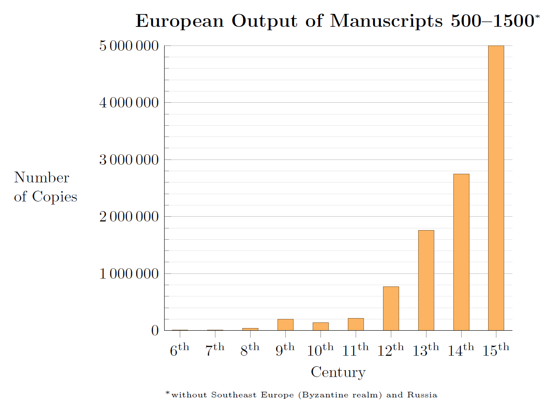
Effects of the collapse of Rome
Rome falls 476 CE
Effects:
  Large-scale centralized rule vanished
  Population fell by 25% due to war and disease
  Less land being farmed
  Lessening of urban life
  Long distance trade almost disappears; Italy is the exception
  Decline in literacy
  Shift in center of gravity from the Mediterranean to north and west

Slide 4
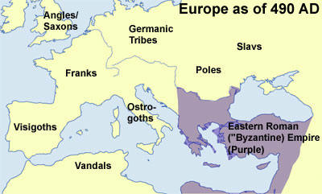
Roman and classical culture survive
Though Rome fell, much of its culture lived on in Western Europe
  Germanic peoples who established new kingdoms had been substantially Romanized already
  Roman items/culture were considered aspects of high prestige
  Germanic rulers adopted Roman-style written law

Slide 5
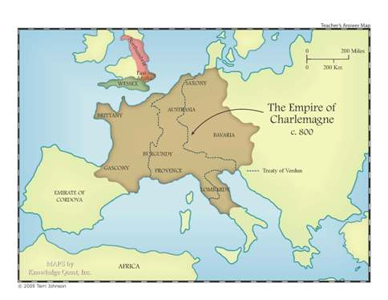
Charlemagne
Several Germanic kingdoms try to recreate Roman-style unity; most successful was Charlemagne
  Closest thing to a unified Europe since the Roman Empire
  Coronation on Christmas Day, 800 said to be the “revival” of the Roman Empire
  Brought on the Carolingian Renaissance; a spirit of intellectual achievement and activity in the Church
  Unification doesn’t last long after his death, but he does establish the foundation for what would become France and Germany.

Slide 6
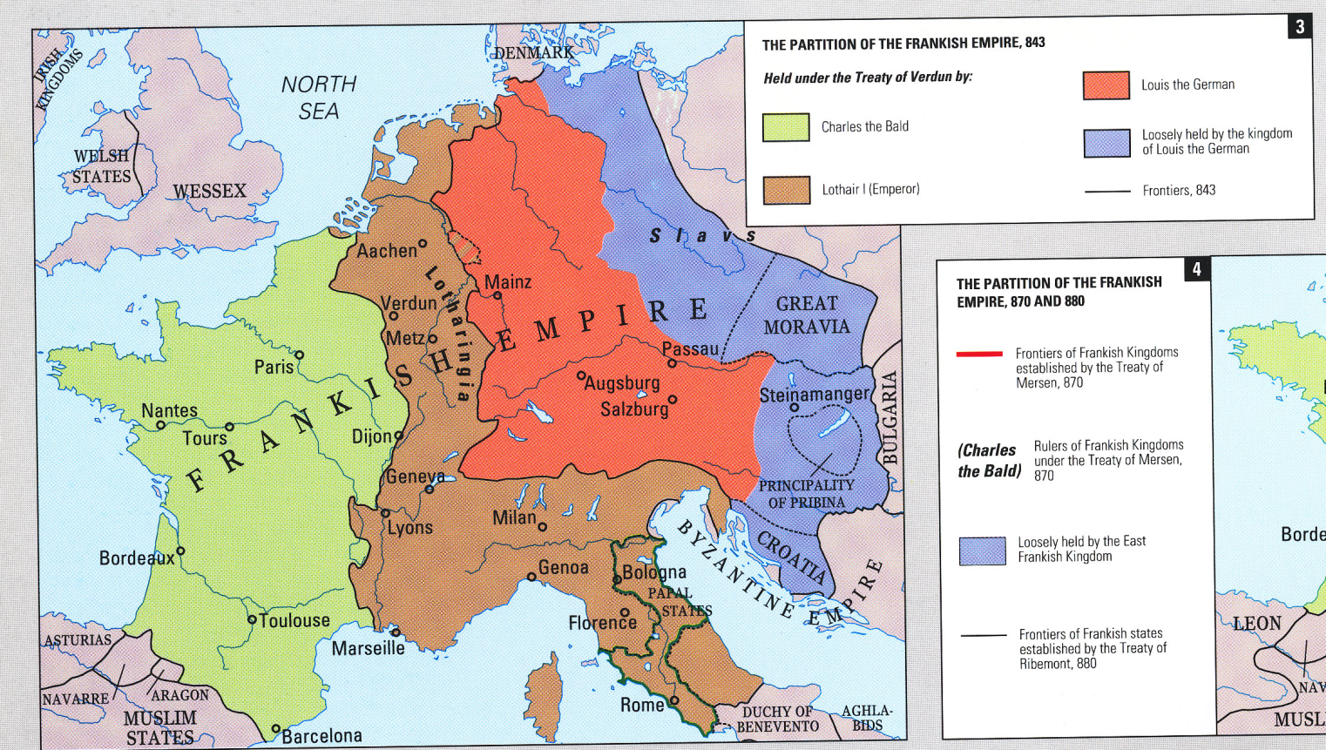
Kingdoms of Western Europe
Many kingdoms were established off and on during the Middle Ages
  Highly fragmented, decentralized societies
  Lots of Local variation among regions of these societies
  Landowning warrior elite exercises power

Slide 7
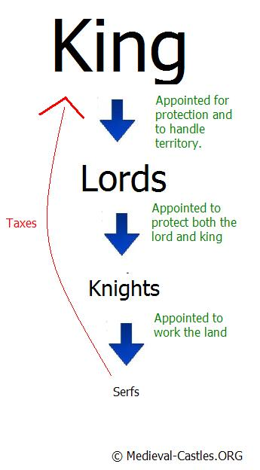
Social Hierarchies: Feudalism
Feudalism was an oppressive economic system.
King would grant large land masses to lords in exchange for a share in the profits.
Lords would then grant smaller land masses , called a fief, to a lesser lord or vassal, in exchange for their military service.
Vassals and lords alike would grant average people , called serfs, protection in exchange for their work on farms

