Slide 1
Zoroastrianism and Judaism
Monotheism and the Search for God in the Middle East

Slide 2
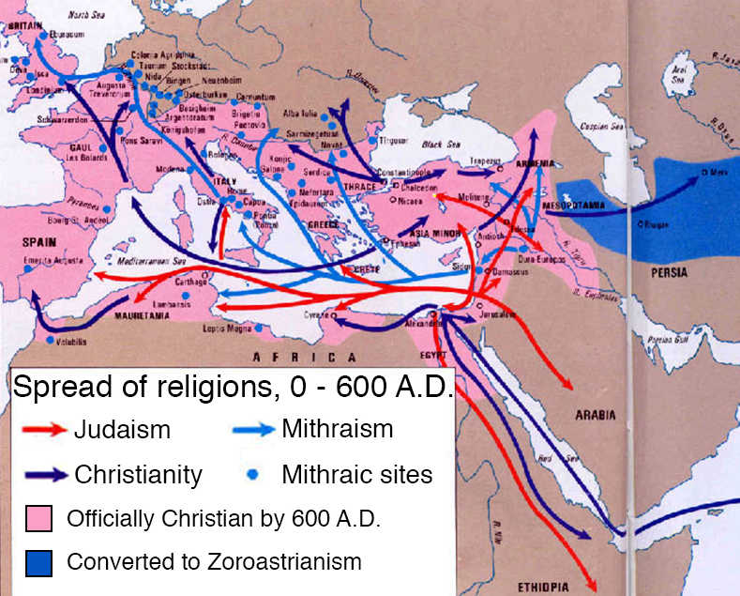
Early Monotheism
Contrary to the multiple gods and goddesses of Greece and Rome, the concept of monotheism began to develop in the Middle East
This radical notion of a supreme deity developed in Zoroastrianism and Judaism and became the basis for both Christianity and Islam

Slide 3
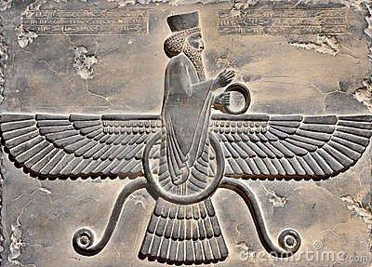
Zoroastrian Beliefs
Persian prophet, Zarathustra, traditionally dated to sixth or seventh century B.C.E.
Single god, Ahura Mazda, is source of truth, light and goodness
Cosmic struggle with Angra Mainyu
Ahura Mazda will eventually win, aided by a final savior
Judgement Day: restoration of world purity and peace
Need for individual to choose good or eveil

Slide 4
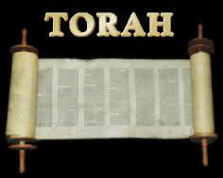
Influence of Zoroastrianism on Judaism
Cyrus the Great conquers the Babylonian Empire and allows Jews to return to Jerusalem.
  However, many remain in Babylon.
  One of these, Ezra, assembled the practices, ceremonies and history of the Jewish people into the Torah and brought it to Jerusalem.

Slide 5

Common Beliefs Between Judaism and Zoroastrianism
Concept of God vs. Satan
Idea of a last judgment and bodily resurrection
Belief in the final defeat of evil with the help of a savior (Messiah)
Remaking of the world at the end of time

Slide 6

Judaism’s Development
Began in Mesopotamia and moved into Palestine
Founder; Abraham.
Enslaved in Egypt but migrated back to Mesopotamia and founded Israel in 1000 B.C.E.

Slide 7
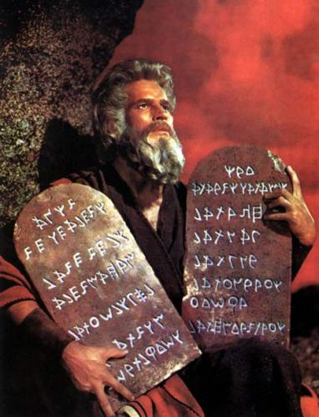
Jewish Conception of God
Yahweh: Jewish God
  Arranged covenants or agreements with his people
    Must recognize only Yahweh as divine
    Circumcision
    Kosher practices
    People were rewarded for obeying covenants, punished on earth for disobedience
  Transcendent deity, but communication was possible with chosen prophets

